Slide 1
Navigating in Workforce Central 8.0 Presented by the Auditor-Controller’s Office

Slide 2
Course topics
Welcome to the Using Your Navigator training session! This session covers the following topics:
What is new in 8.0
Logging on/signing out using a navigator
Benefits of using a navigator
Managing widgets and workspaces
Using the Related Items pane
Updating time cards
Signing Off Payroll
Audit Widget
Notes:
This training covers the “basics” of using a navigator and does not include how to use individual widgets for specific tasks;

Slide 3
Notes:
The timecards have changed a bit they have looked the same for quite some time, so today we will explore some of the changes such as the new layout, the new Audit widget, some changes and enhancements with the sign off process and screen configuration options.

Slide 4
Notes:
Enhanced look, it definitely looks different it looks a little more modern, the layout is configurable, the timecard is now JAVA free. You can now within the timecard change the employee you are viewing without going back to the quickfind. The exception indicators have been enhanced a bit and there are some new ones.

Slide 5
Notes:
I did mention that the timecard has changed quite a bit so if you take a look at this slide you can see the old layout verses the new layout. It has an enhanced update look and that some of the columns have changed. Some columns are new and some are in a different layout than you may be used to. When we get into the system I will go over these in more depth.

Slide 6
.
Notes:
One enhancement is the Audit Widget this new widget is available to review the audit trail for employees. This used to be on a tab located on the timecards. This audit widget is great to review changes, comments, historical corrections, signoff and approvals and you don’t have to access the employees timecard anymore to access this feature. We will look at this audit widget some more when we get into the program.

Slide 7
.
Notes:
There also are some enhancements in the approval and signoff process, there are some color indicators. Now you have a quick visual reference to see if a time card has been approved or signed off. (Read the Color Reference chart). The colors we will be using will be the Yellow and Grey.

Slide 8
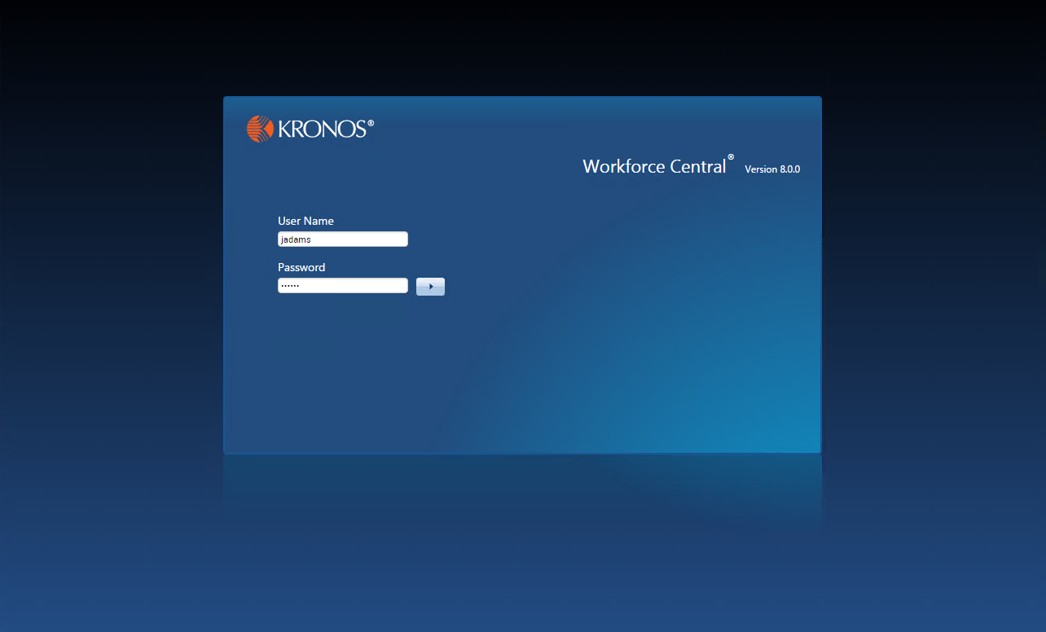
Logging on
Log in using your unique User Name and Password
Notes:
Signing on is the same as in the old kronos and you will use your current log in information

Slide 9
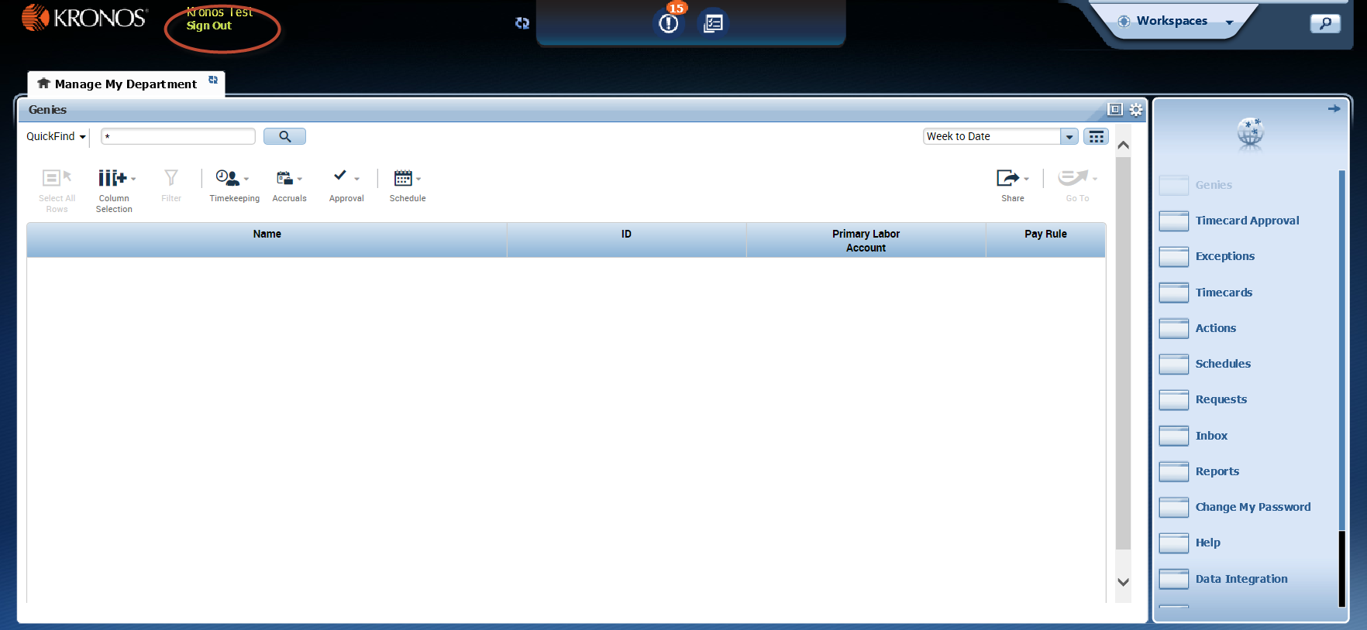
Signing out
When you are done, be sure to Sign Out before closing your browser!
Notes:
Explain the importance of signing out after each session. Point out that simply closing the browser window without signing out leaves the session open until it times out, which can be a security risk.
NOTE: If a user fails to save and the system time out occurs because of inactivity, all unsaved edits will be lost.

Slide 10
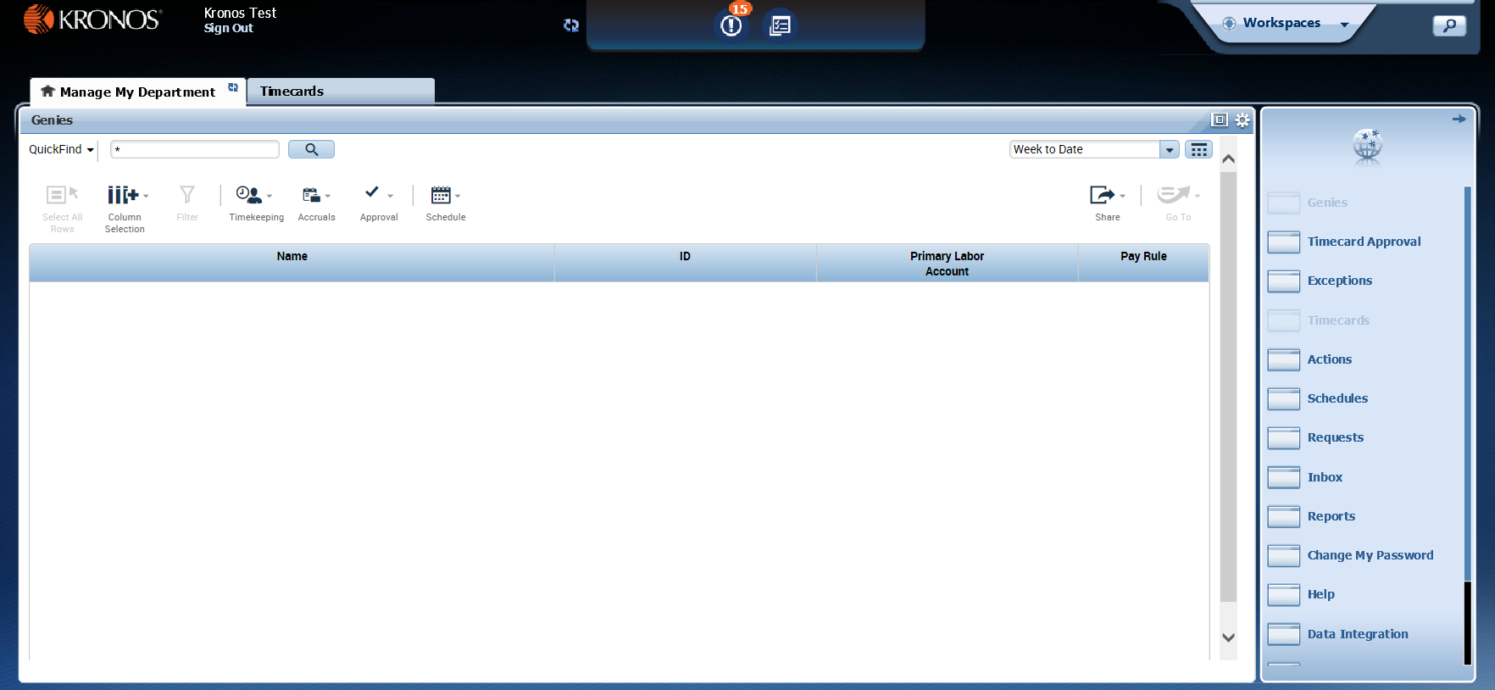
Benefits of using a navigator
Your navigator has been tailored for your specific job role
(Continued)
Notes:
Each employee will only see the tools and data that are relevant to their job role—no need to sift through irrelevant info to find what you need.

Slide 11
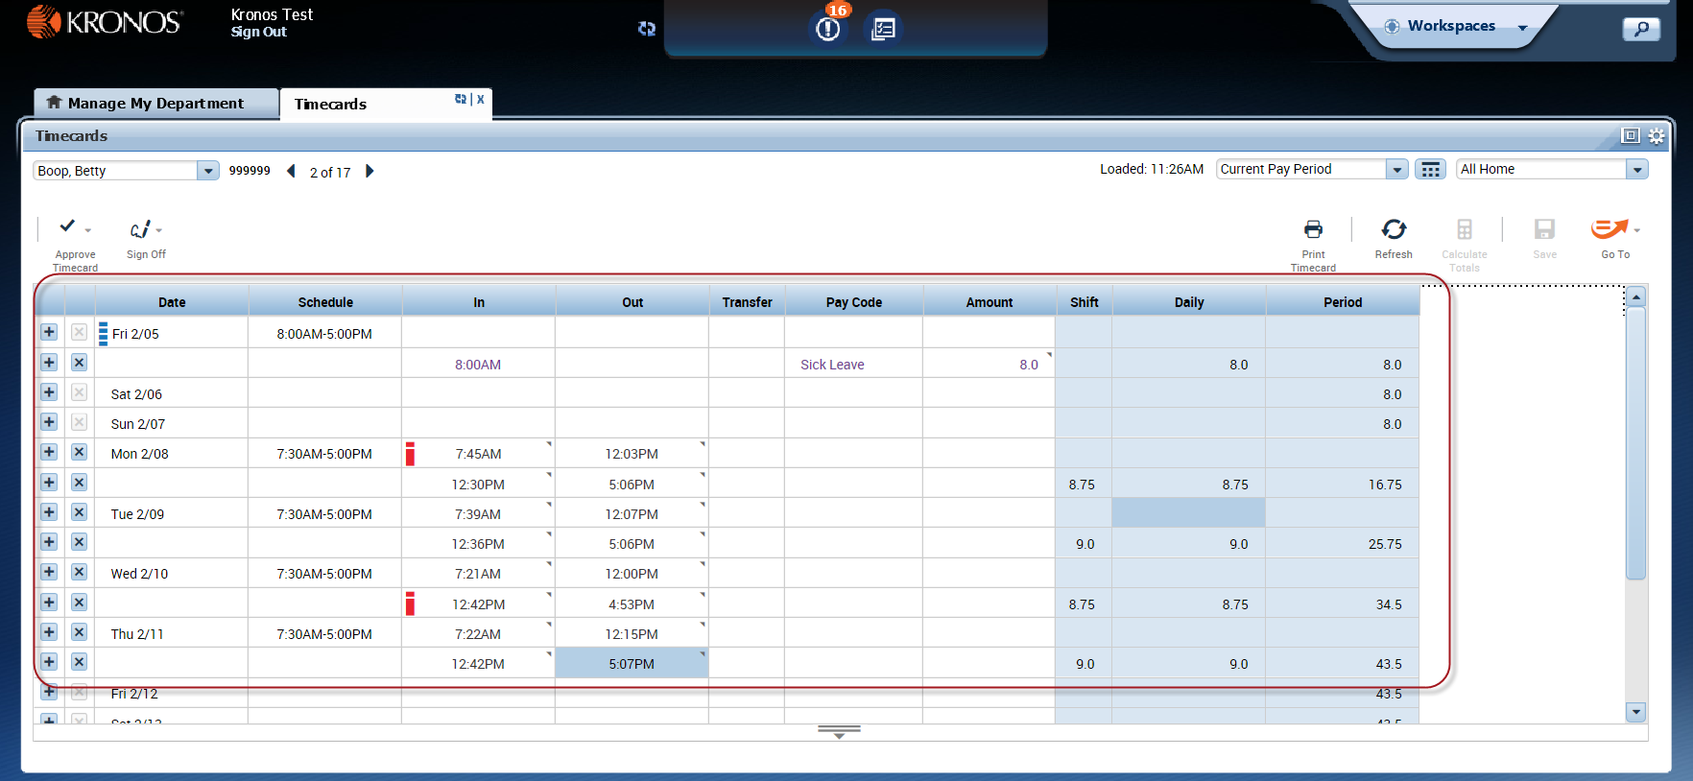
Benefits of using a navigator (Continued)
Navigators display up-to-date information
(Continued)
Notes:
Data is updated each time the navigator is opened, so you always know that you are looking at the most current information available.

Slide 12
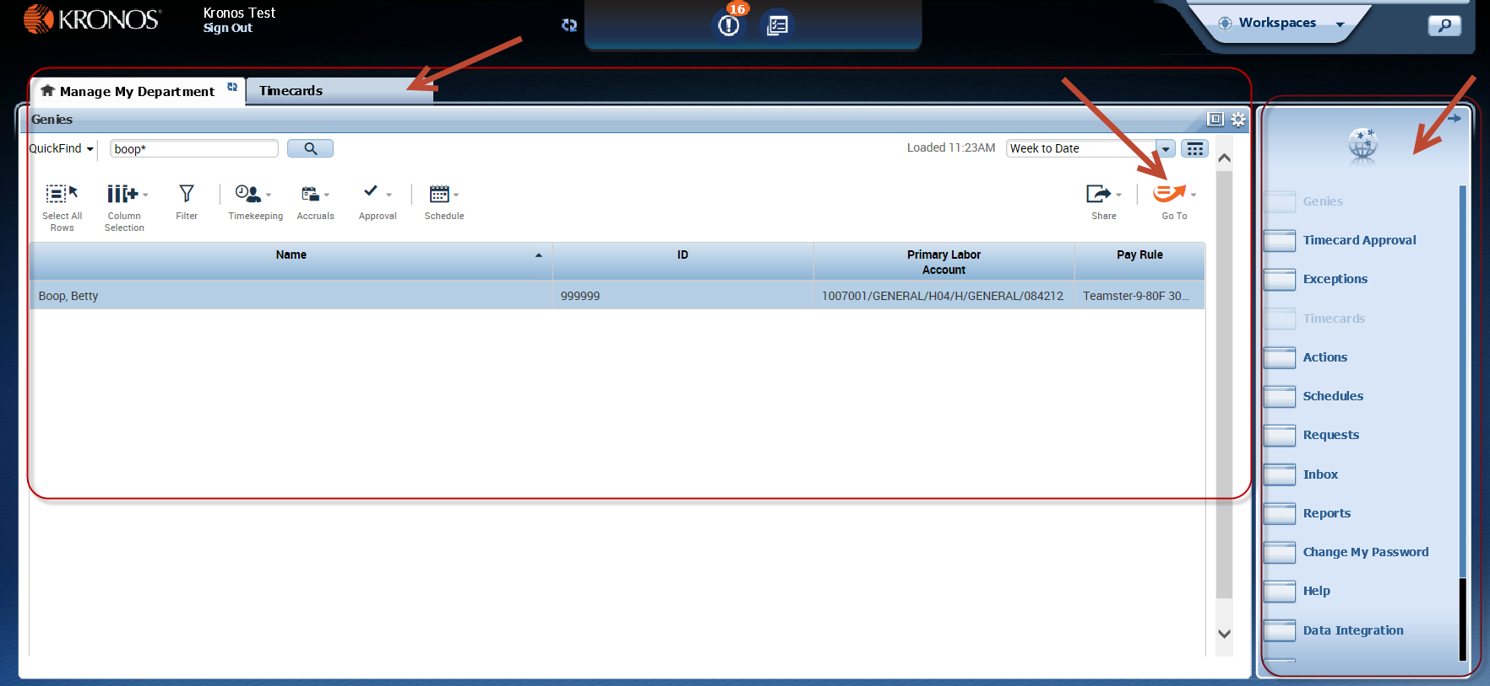
Benefits of using a navigator (Continued)
Navigators are organized so that related information is grouped and displayed together.
Notes:
The navigator workspaces have been organized into individual parts called “widgets,” and that these widgets have been grouped together to support specific tasks. For example, the widgets shown here help employees enter and review their employees actual worked time.

Slide 13
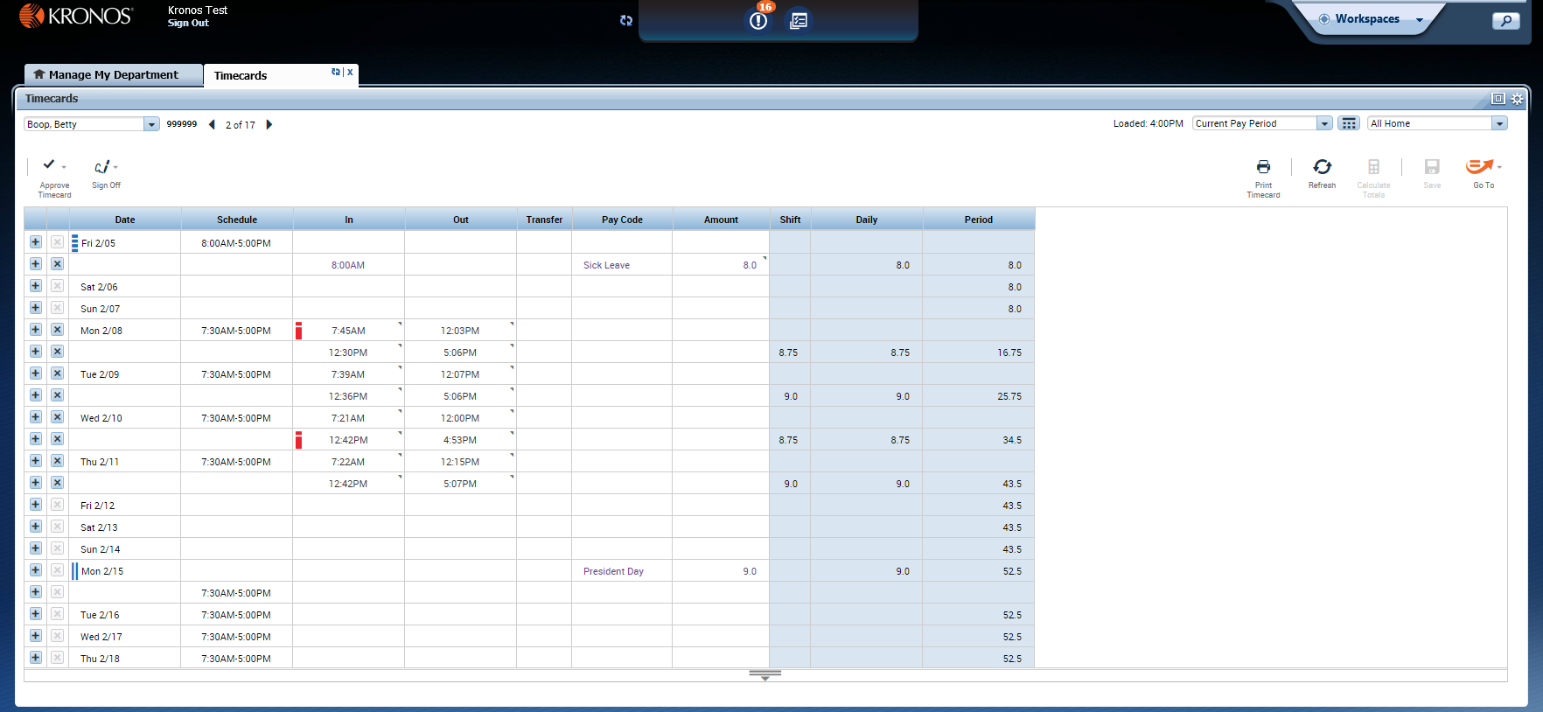
What is a widget?
Widget = a task-oriented tool or view into Workforce Central
Notes:
This image shows a workspace containing two widgets. Each widget is a task-oriented tool or view into Workforce Central.
.

Slide 14
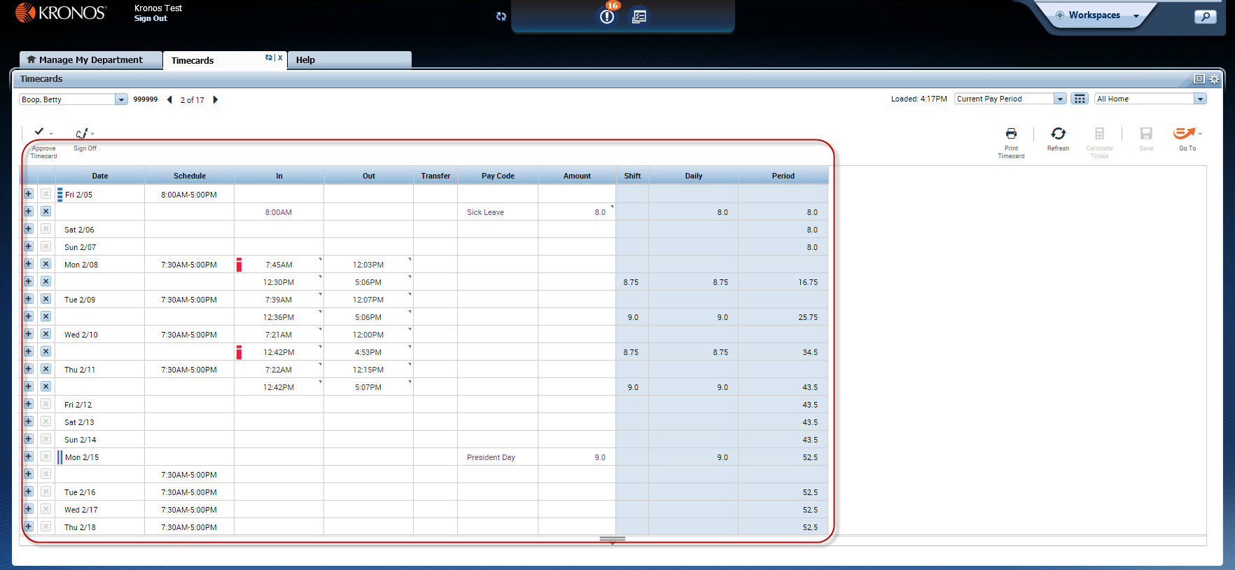
What is a workspace?
Workspace = a collection of one or more widgets bound together for completing a task or solving a specific business problem.
Notes:
Everything you needs to process your employees timecards are located in one area. The Timecard workspace shown here includes widgets that help a Manager view schedules and enter and review the time that was worked.

Slide 15
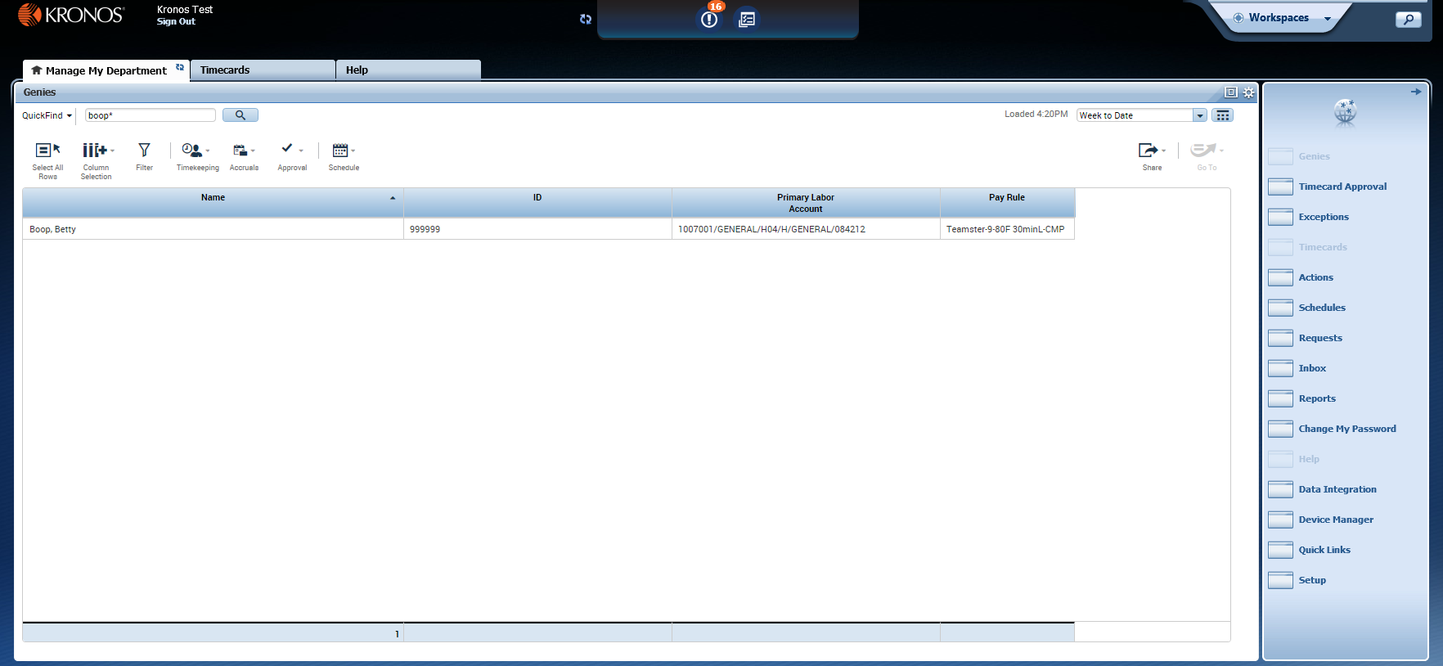
Structure of a workspace
Each workspace has one or more primary views, and may also have a number of available secondary views.
Notes:
Workspaces are configured with a specific layout, specifying the quantity and position of its views. When a workspace first opens, it fills these views with predefined widgets—the ones most likely to support a typical task in this workspace. However, users have a lot of control over how many views are showing at any given time, and which widgets occupy each of the views.

Slide 16
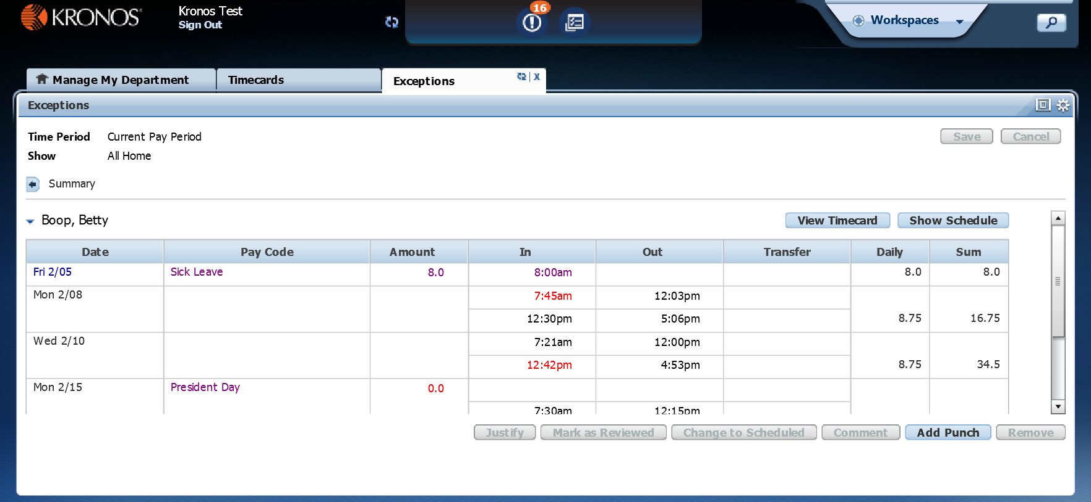
Primary views
Primary views are for making edits and doing work
Notes:
Primary views are for editing and doing work. They are typically the largest views in a workspace, to show more information and enable maximum functionality. Typically, when you want to work in a widget you will move that widget into a primary view.

Slide 17
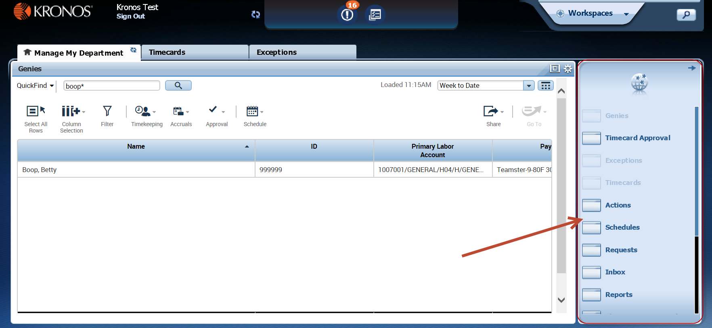
Related Items
The Related Items pane contains additional widgets related to the kind of tasks performed in the workspace.
Notes:
Additional widgets that can be helpful in performing a task these widgets are held “in reserve” in the Related Items pane.
Open widgets appear grayed out, while widgets not yet open in the workspace appear in bold.
There are a few ways to open a widget in the workspace) by dragging it to a view, or open it in its own temporary workspace by clicking it in the pane.

Slide 18
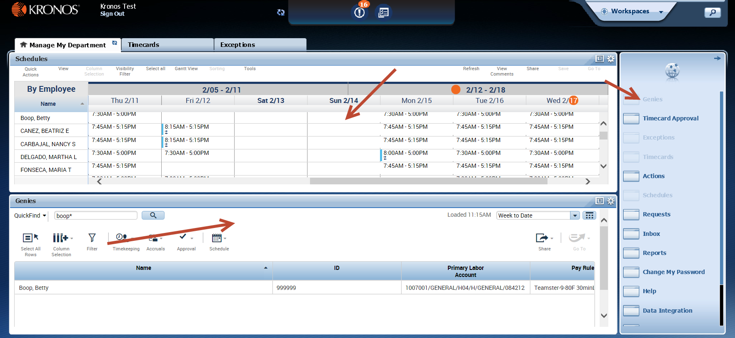
Adding widgets to a workspace
Some workspaces have room for additional widgets; these can be added from the Related Items pane.
Notes:
If this is the case, dragging a widget from the Related Items pane will add it to the workspace, rather than swapping it with an open widget. In this example, the schedule widget has been dragged from the Related Items pane out to the primary position. Manage my Department which had been in the primary position, was automatically moved into a secondary position; one primary view and a secondary views are now available.

Slide 19
Ways to a manage an active workspace
Remember, you have the means to temporarily tailor each workspace to suit your immediate needs:
Maximize/Restore icon: Click a primary view’s Maximize icon to enlarge the view to fill the entire screen. Click again to return to its original size.
Title bar: Drag a widget’s title bar (while in a secondary view) to swap it into a different view (primary or secondary).
Resize bar: Drag to view more of one widget and less of another widget.
Gear icon: Open to access additional display options, such as Close to return the widget to the Related Items pane, or Pop-out to swap the widget into a primary view.
Notes:
Read the sheet above

Slide 20
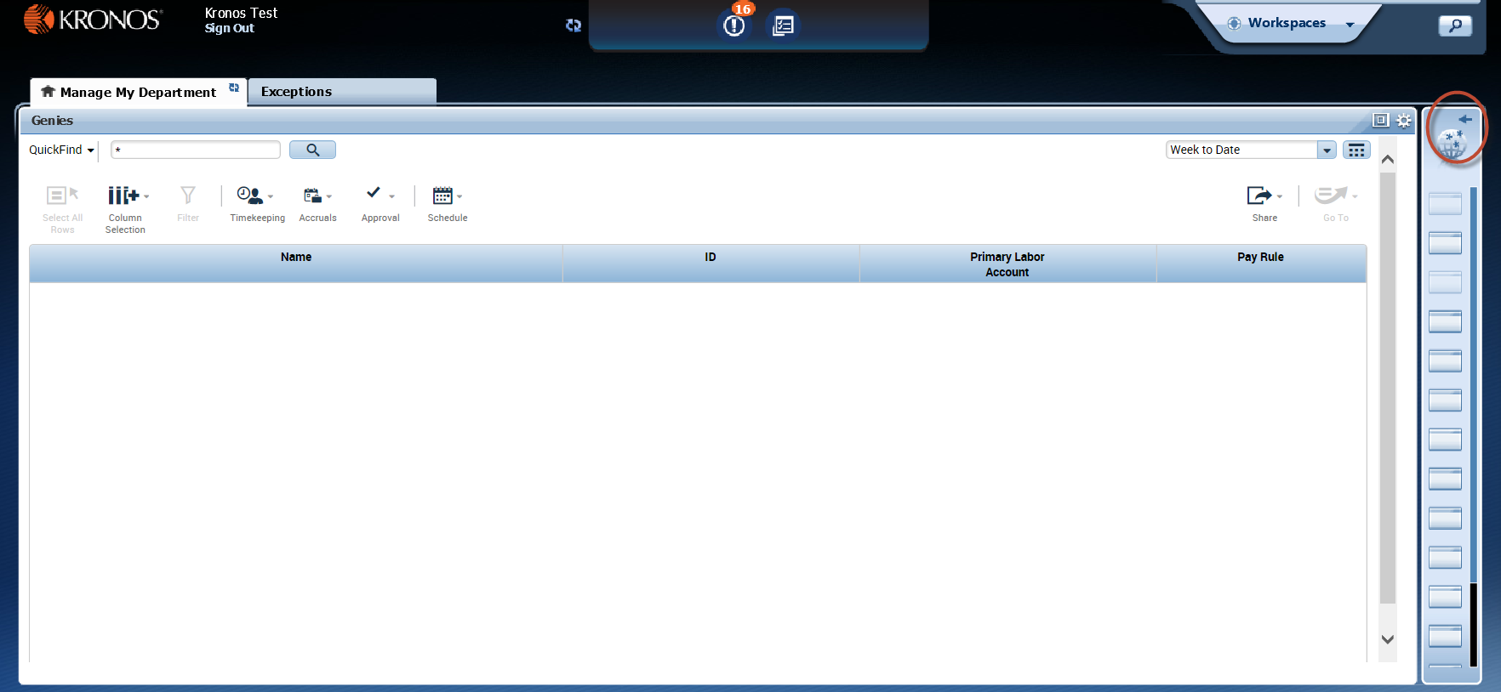
Opening/Closing the Related Items pane
You can close the Related Items pane to enlarge the workspace, and open it again when you need it.
Notes:
The Related Items pane can be opened or closed by clicking its arrow icon. Explain that you can close it to make more room in the workspace for viewing active widgets, and open it when you need to access an inactive widget.

Slide 21
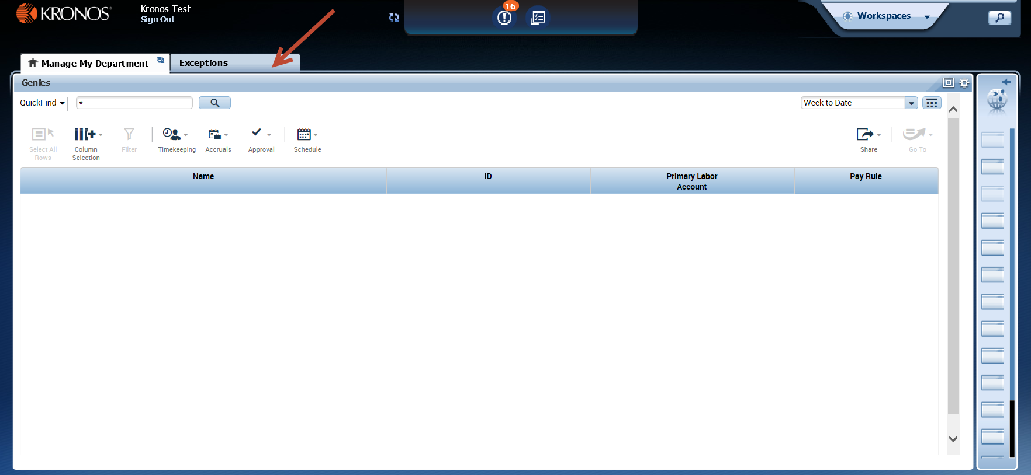
Temporary workspaces
You can open a widget in a temporary workspace by clicking its name in the Related Items pane.
Notes:
Describe how to open a widget in a temporary workspace, and why you might want to do that (i.e. to have more working area). Point out that you close the workspace by clicking X in its tab, as with any other workspace. You can also refresh the data in the workspace by clicking the Refresh icon on the tab.

Slide 22
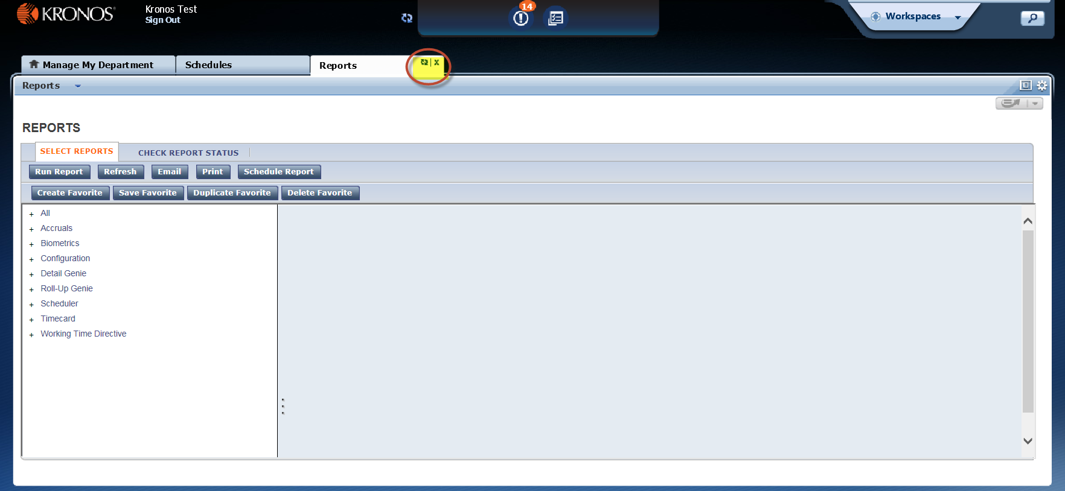
Closing temporary workspaces
If you have opened a temporary workspace, you can close it by clicking X in its tab.
Notes:
Explain how to close an active workspace when it is no longer needed. Be sure to point out that an employee’s home workspace (indicated by the house icon in the workspace’s tab) cannot be closed.

Slide 23
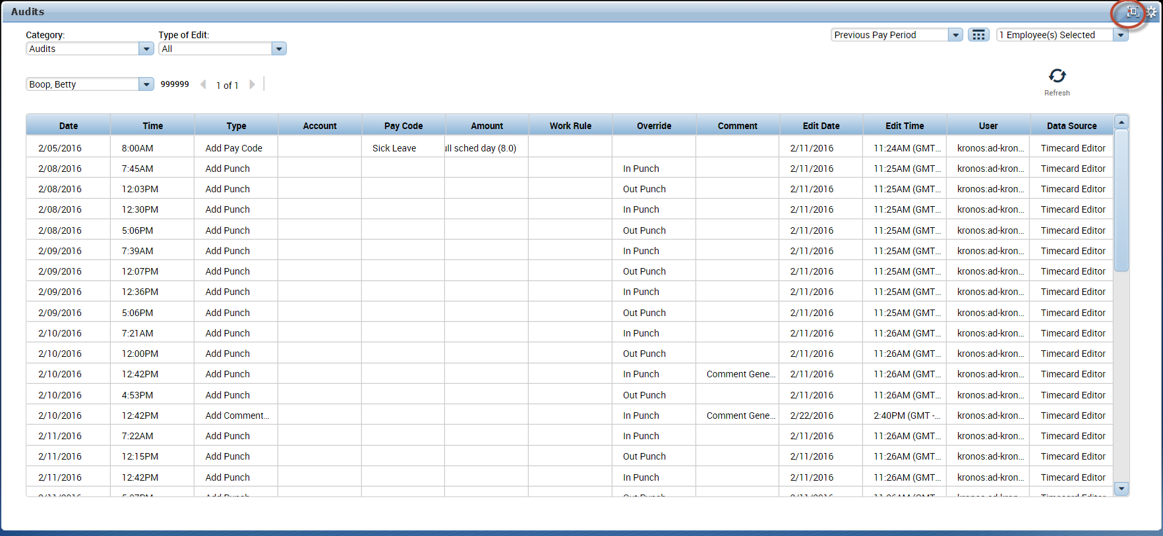
Maximizing a primary view
You can maximize a primary view to have it fill as much of the screen as possible.
Notes:
Point out that if you find you need more space to work with a widget in a primary view, you can maximize that primary view and fill as much of the screen as possible by clicking its Maximize icon. To return it to its normal size, simply click the same icon again (now labelled “Restore Down”).

Slide 24
Now lets look at the New Kronos
http://ad-kronos1.co.imperial.ca.us/wfc/navigator/logon

