Slide 1
Human Resources Overview
2019
Changes in ONESolution 20.X

Slide 2
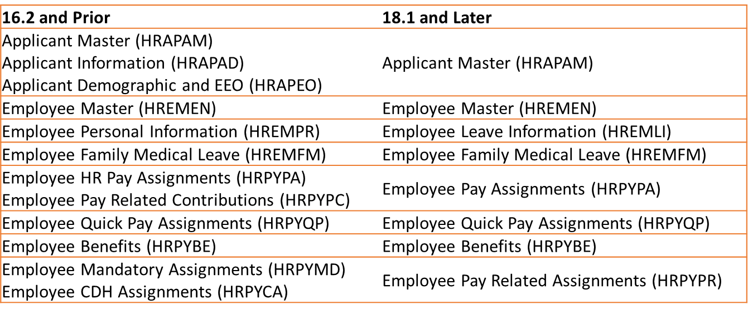
HR Employee Screen Changes
Simplified and reorganized layout

Slide 3
Applicant Tracking
Applicant Master (HRAPAM)
Applicant Information (HRAPAD)
Applicant Demographic and EEO (HRAPEO)
Applicant Master (HRAPAM)

Slide 4
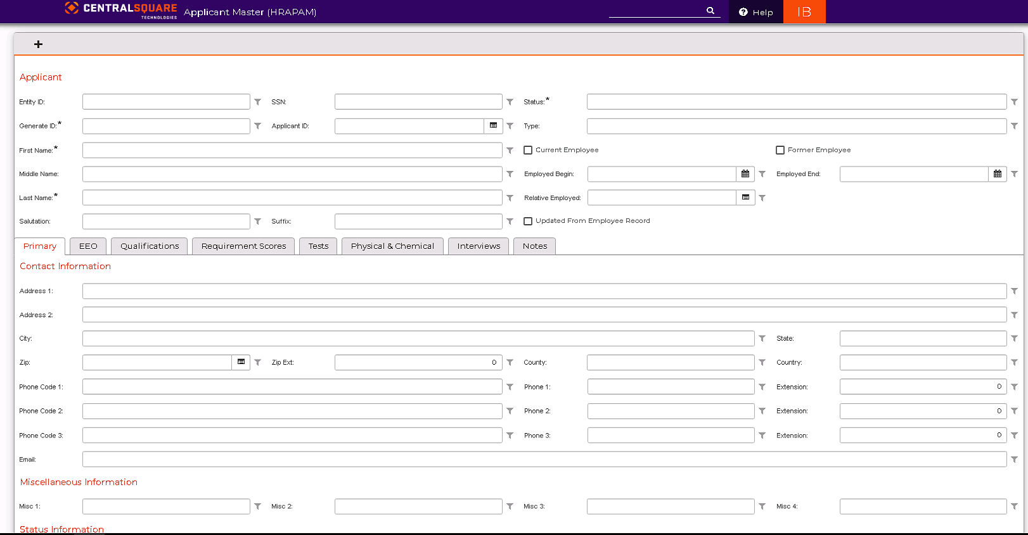
HRAPAM- Applicant Master

Slide 5
Employee and Personal Information
Employee Master (HREMEN)
Emergency Contacts
I9 Tracking
EEO
Additional Addresses
Employee Leave Information (HREMLI)
Employee Family Medical Leave (HREMFM)

Slide 6
HREMEN- Employee Master

Slide 7
HREMEN- Employee Master

Slide 8
HREMEN- Employee Master

Slide 9
HREMEN- Employee Master

Slide 10
HREMLI- Employee Leave Information

Slide 11
HRPYBE- Employee Benefit Assignment

Slide 12
HRPYBE- Employee Benefit Assignment

Slide 13
HRPYBE- Employee Benefit Assignment

Slide 14
HRPYBE- Employee Benefit Assignment

Slide 15
HRPYBE- Employee Benefit Assignment

Slide 16
Employee Pay Related Assignments
Employee Mandatory Assignments (HRPYMD)
Employee CDH Assignments (HRPYCA)
Employee Pay Related Assignments (HRPYPR)

Slide 17
HRPYPR- Employee Pay Related Assignments

Slide 18
HRPYPR- Employee Pay Related Assignments

Slide 19
HRPYPR- Employee Pay Related Assignments

Slide 20
Employee Pay Assignments
Employee HR Pay Assignment (HRPYPA)
Pay Related Contributions (HRPYPC)
Employee Pay Assignments (HRPYPA)

Slide 21
HRPYPA- Employee Pay Assignments

Slide 22
HRPYPA- Employee Pay Assignments

Slide 23
HRPYPA- Employee Pay Assignments

Slide 24
HRPYPA- Employee Pay Assignments

Slide 25
HRPYPA- Employee Pay Assignments

Slide 26
HRPYPA – Employee Pay Assignment

Slide 27
HRPYQP - Employee Quick Pay Assignment

Slide 28
HRPYQP - Employee Quick Pay Assignment

Slide 29
HRPYQP - Employee Quick Pay Assignment

