Slide 2
OS 18.1 Desktop Navigation
Navigating the 18.1 ONESolution Desktop Environment
Presented By Cassandra Shrum

Slide 3
Agenda
During this breakout session the following topics will be covered:
Workspaces Overview
Navigation in the ONESolution Workspaces
Creating and Modifying Workspaces

Slide 4
Workspaces Overview
A Brief Overview of Workspaces

Slide 5
Workspaces Overview
The Workspaces main page acts as a single navigation point for all the ONESolution workspaces and applications.
ONESolution customers use the main Workspaces page to access workspaces, task centers, components, and applications of ONESolution product suites.
Workspace pages are designed in a generic way that provides customizable layouts, components, and settings to match the specific requirements of your agency.
The ability to customize workspace elements is dependent upon the security restrictions configured at the agency level.

Slide 6
Workspaces Overview
Features of the Workspaces main page
Integrated workspaces for ONESolution Finance, ONESolution Public Administration, and other application suites.
Dynamic and configurable workspaces, components, and task centers.
Ability to position components within a workspace.

Slide 7
Navigation in the ONESolution Workspaces
Using features of the ONESolution Workspaces

Slide 8
Navigation in the ONESolution Workspaces
The Workspaces main page is divided into three sections:
Top banner
Navigation panel
Main window
Top banner - The banner located at the top of the page displays the following:
ONESolution logo and name of the application.
Search field - Allows you to search for application screens.
Help link - Displays related help topics.
User Profile icon - Displays user profile information and notifications.

Slide 9
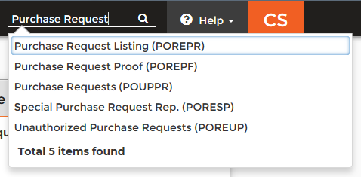
Navigation in the ONESolution Workspaces
Using the Search field
You can search for the functional reports, application screens, and other data within various suites using the Search field.
Filtered search results display in the drop-down list as you type.
Searches are not case sensitive.
Searches can be done using names or menu masks

Slide 10
Navigation in the ONESolution Workspaces
Accessing Screen-Specific Help
Each screen has one or more screen-specific Help documents available for it.
The Help documents are accessed using the Help button located in the top right corner of the screen.
If a single document is available, it will open in a web page for viewing when the Help button is clicked.
If multiple documents are available, the button will display a down-arrow symbol and will display a list of available documents when clicked.
Click on the desired document title in the drop-down list to open that document in a web page for viewing.
Help documents may contain links to other related topics. When clicked, the link will open a web page containing the related topic.

Slide 11
Navigation in the ONESolution Workspaces
User drop-down Menu
The user menu is located in the top-right corner of the banner. The menu is indicated by a circle icon containing your initials.
This is where you can view your profile information, view your notifications, change your password (if permitted), and sign out of Workspaces.
Note: A number appears above your initials and on the Notifications line if you have unread notifications.

Slide 12
Navigation in the ONESolution Workspaces
Viewing your user profile
Click the drop-down arrow next to your initials in the banner.
Click View Profile to display your profile information. The profile page opens in a new tab. The User Profile page contains the following items:
User Name - Displays your complete domain and user name as configured within the environment.
Full Name - Displays your full name as configured within the environment.
Environment - Displays the environment name that you are currently logged into.
Session ID - Displays the session identification token for the current session.
Change Password - Allows you to change your password.
Note: The View Profile button is controlled by navigation security settings.

Slide 13
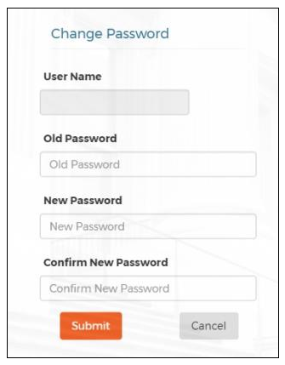
Navigation in the ONESolution Workspaces
Changing your password
Depending on the type of network user account you have, you may be able to change your password through the User Profile screen. If this feature is active, the Change Password link appears below your initials
Click View Profile to display your profile information. The profile page opens in a new tab.
Click Change Password in the User Profile window.
Type your user name in the Username field.
Type your current password in the Old Password field.
Type your new password in the New Password field.
Retype your new password in the Confirm Password field.
If you decide not to change your password at this time, click Cancel to close the Change Password window.
Click Submit to change your password.

Slide 14
Navigation in the ONESolution Workspaces
Viewing your notifications
Click Notifications in the user menu to display your notifications.
The notifications page opens in a new tab.
Note: If you have unread notifications, a number appears to the right of the Notifications link indicating the number of unread notifications.
The Notifications viewer displays your notifications.
If no notifications are available a message will be displayed such as the one indicated in the image to the right.
If notifications are available, the notification message will be displayed in this area on the new tab.

Slide 15
Navigation in the ONESolution Workspaces
Navigation panel - The Navigation panel located on the left side the page displays the following:
Workspaces node - Displays a list of workspaces assigned to you.
Task Center node - Displays a list of task centers assigned to you.
Main menu node - Displays the component modules based on your application.

Slide 16
Navigation in the ONESolution Workspaces
Workspaces Node
The Workspaces Node contains a drop-down list of available workspaces.
When a workspace is selected from the list, the Task Nodes of that workspace are loaded into the screen.

Slide 17
Navigation in the ONESolution Workspaces
Task Nodes
The Task Nodes section contains a list of available Task Nodes.
When a Task Node is selected from the list, the Components of that Task Node are loaded into the main screen area.
Components are links, reports, tasks, and jobs that belong to the Task Node.

Slide 18
Navigation in the ONESolution Workspaces
The main menu option displays workspace components and task centers.
Components vary depending on your application suite.
The Main Menu replaces the ALL menu in IFAS and the Navigation Points menus in ONESolution versions 16.2 and lower.

Slide 19
Creating and Modifying Workspaces
Customizing Your ONESolution Workspaces

Slide 20
Creating and Modifying Workspaces
Workspaces Designer mode provides the ability to create, edit, and customize workspace and component items.
Edit mode exists if you have sufficient rights to modify workspaces.
If you do not have edit rights, the Edit mode controls do not display.
Note: Edit mode is only available in medium and large screen resolutions. Editing controls are disabled in smaller screen resolutions.
If you shrink the screen while in edit mode, the following message displays on the screen. You can return to the original screen size to re-enable editing controls.

Slide 21
Creating and Modifying Workspaces
The Advanced Options menu displays at the bottom of the Navigation panel if you have edit rights.
Expand the Advanced Options node by clicking on the arrow next to the label to display the actions available.
Add New Task Center - Opens the New Task Center window.
Add New Workspace - Opens the New Workspace window.
Edit Workspace - Opens the Edit Workspace Details window.
Delete Workspace - Allows you to delete the current workspace.

Slide 22
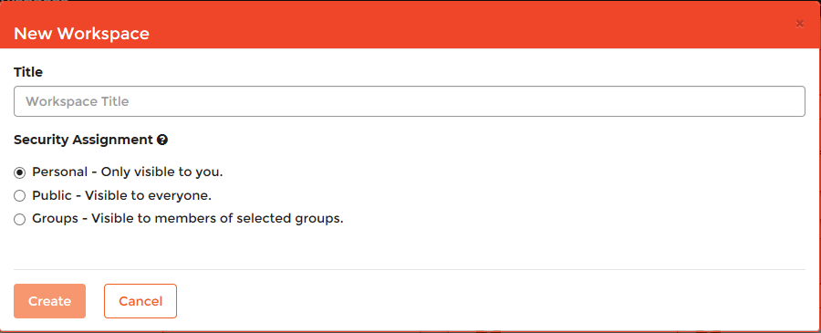
Creating and Modifying Workspaces
Adding a new workspace
Click Add New Workspace in the Advanced Options panel to display the New Workspace window.

Slide 23
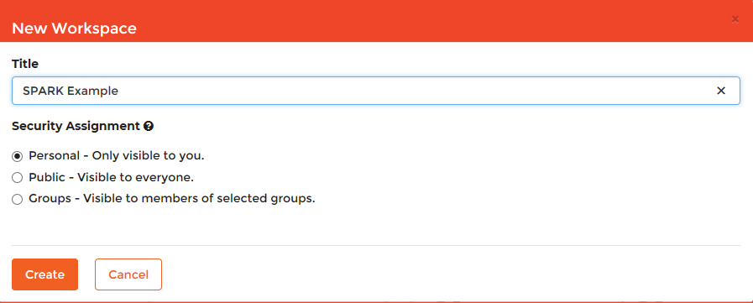
Creating and Modifying Workspaces
Type a name for the new workspace in the Title field.
Select one of the following security types in the Security Assignment section:
Personal - Visible only to you.
Public - Visible to everyone.
Groups - Visible to members of selected groups.
Click Create to save and add the new workspace to the Workspaces note.

Slide 24
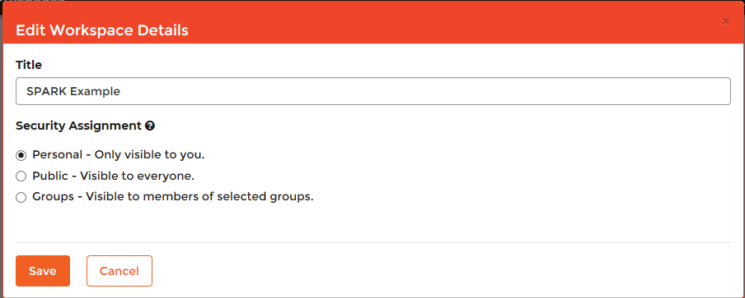
Creating and Modifying Workspaces
Modifying an existing workspace
Click Edit Workspace in the Advanced Options panel to display the Edit Workspace Details window.

Slide 25
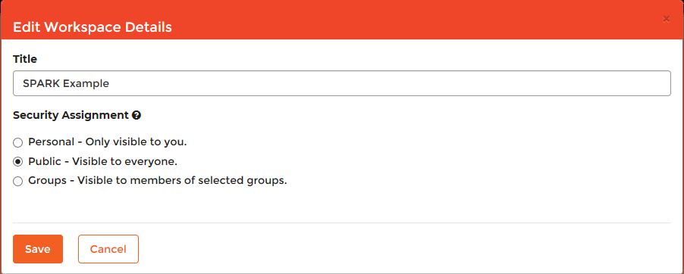
Creating and Modifying Workspaces
This function allows you to update the title or security for the selected workspace.
Click Save in the Edit Workspace Details window to save your changes.

Slide 26
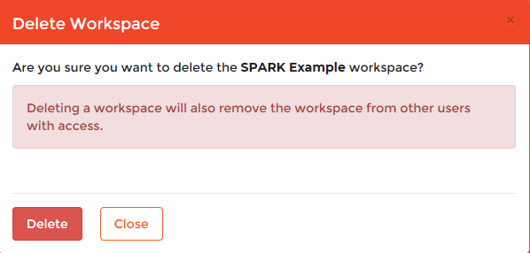
Creating and Modifying Workspaces
Deleting an existing workspace
Click Delete Workspace in the Advanced Options panel to display the Delete Workspace window.
Click on the Delete button to confirm that you want to delete the workspace.

Slide 27
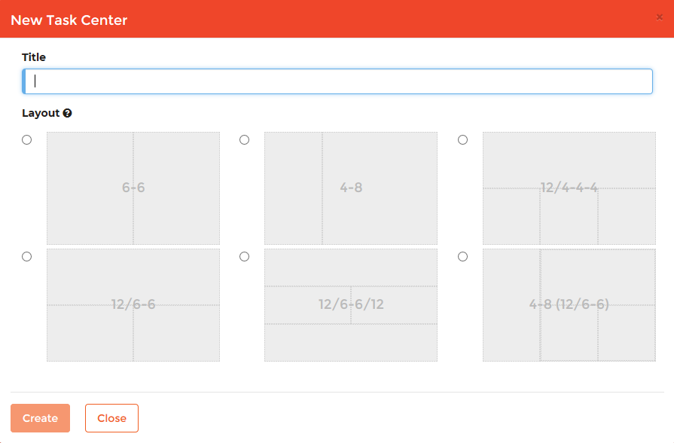
Creating and Modifying Workspaces
Creating a New Task Center
Click Add New Task Center in the Advanced Options panel to display the New Task Center window.

Slide 28
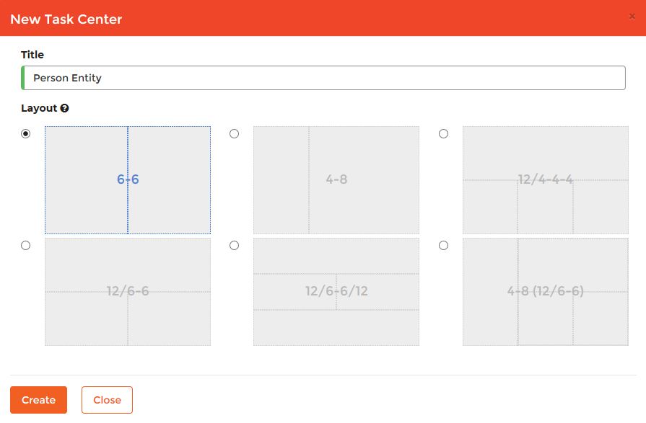
Creating and Modifying Workspaces
Type a name for the new task center in the Title field.
Select a display mode in the Layout section.
Click Create to add the new task center.

Slide 29
Creating and Modifying Workspaces
Note: After creating the new task center:
The title displays in the Navigation panel on the left.
The main page displays in Edit mode on the right and an Edit Toolbar is displayed.
The layout you selected for this task center is indicated by a dotted wire-frame

Slide 30
Creating and Modifying Workspaces
The Edit toolbar contains the following elements:
Add new component - Use this to add a new component window to the task center.
Edit page details - Use this to change the task center title and layout.
Save changes - Saves changes you made to the task center.
Delete task center - Use this to delete the new task center and restore the workspace.
Revert changes - Use this to revert an edited task center to its original state.
Undo changes - Use this to undo your current changes.

Slide 31
Creating and Modifying Workspaces
Adding a new Component:
Click the Add new component tool to open the Add Component window.

Slide 32
Creating and Modifying Workspaces
Select one of the following component types:
• Cognos - Analytics component.
• Links - Component that displays navigational links
• My Jobs - Displays the most recent jobs created by you
• My Tasks - Displays the most recent pending and on-hold tasks assigned to you
Click Add to add the component and continue editing the component settings.

Slide 33
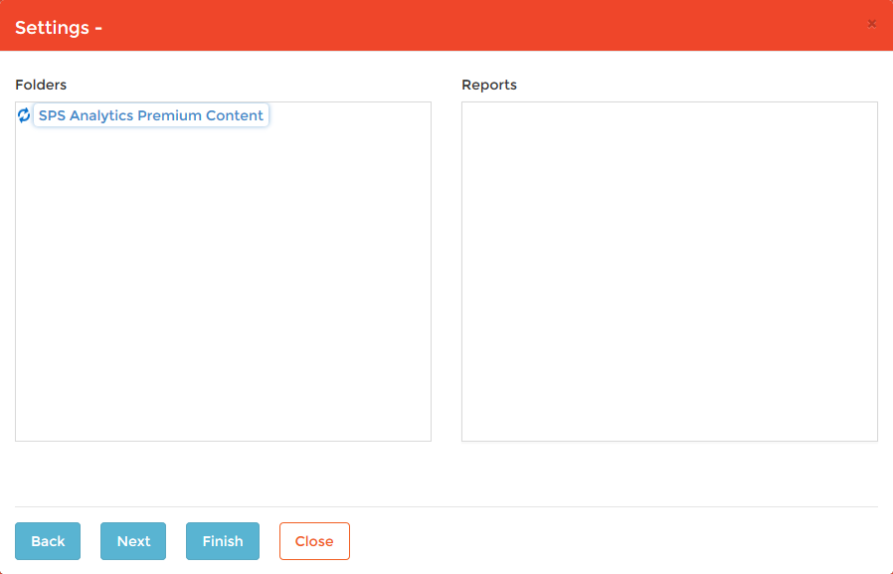
Creating and Modifying Workspaces
Adding a Cognos Component
After selecting the Cognos component in the Add Component window, click on the Add Button.
A Settings window will appear and allow you to select the reports to be included.

Slide 34
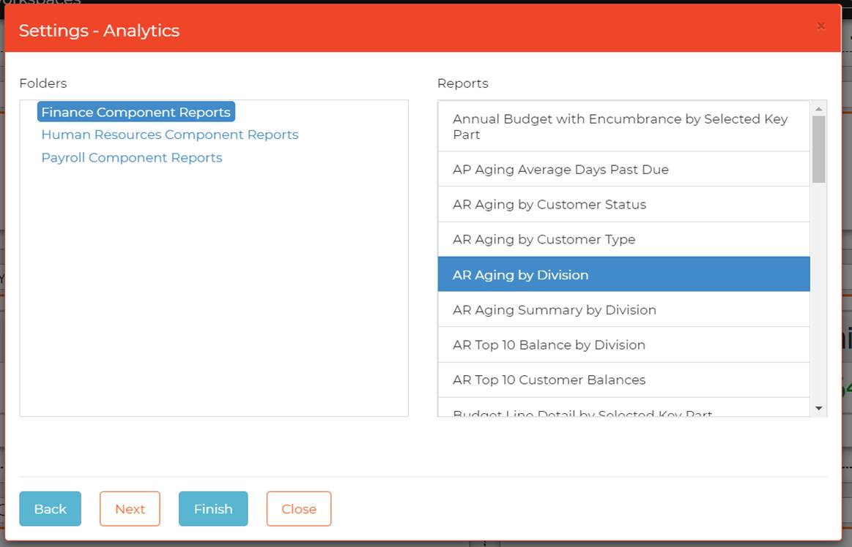
Creating and Modifying Workspaces
Select a folder containing the report desired from the Folders pane.
Select the desired report from the Reports pane.
Click the Finish button to complete the operation.

Slide 35
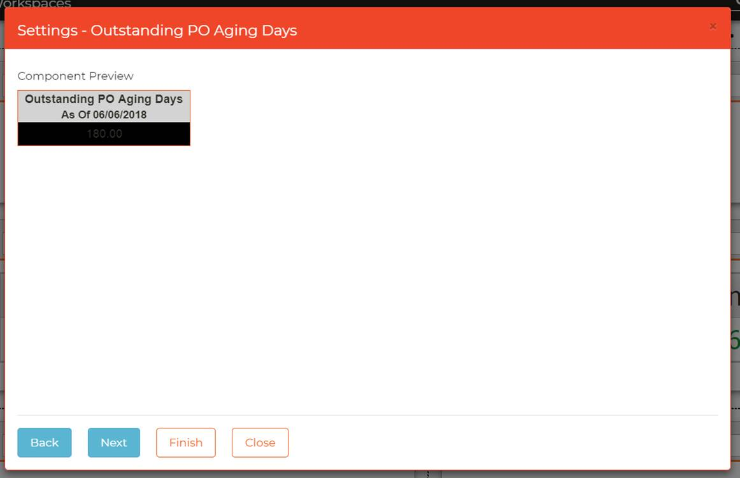
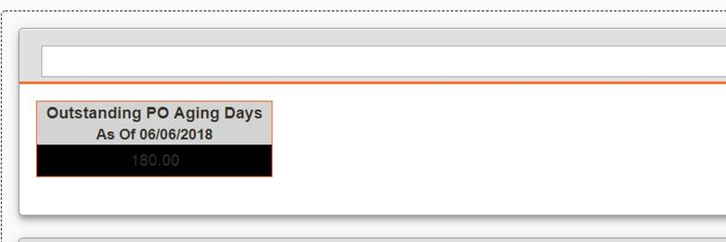
Creating and Modifying Workspaces
After clicking on the Finish button, a Component Preview for the report will be shown in the Settings window for the report.
Click the Finish button to complete adding the report to the task list.
The component containing the links does not contain a name.
To add a name to the component, click in the name field and enter the desired name.

Slide 36
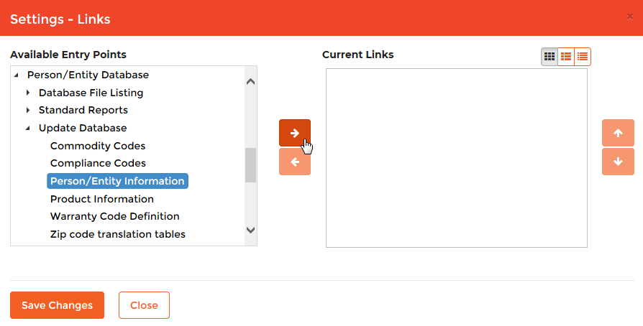
Creating and Modifying Workspaces
Adding a Links Component
After selecting the Links component in the Add Component window, click on the Add Button.
A Links Setting window will appear.

Slide 37
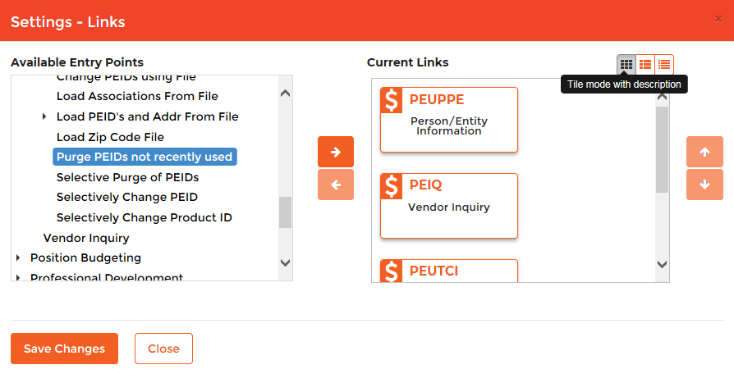
Creating and Modifying Workspaces
Adding a Link component
Locate the link to be added in the Available Entry Points list by navigating the folder structure.
After selecting the entry point link, click on the right arrow button to move the link to the Current Links pane.
Continue adding the desired links in this manner until all have been moved to Current Links.
Click the Save Changes button to save the changes made.

Slide 38
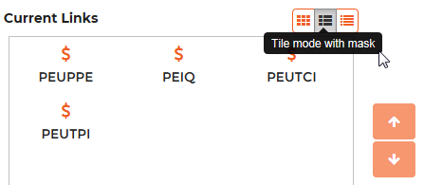
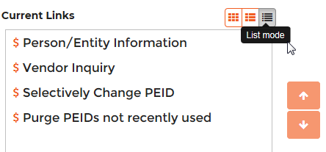
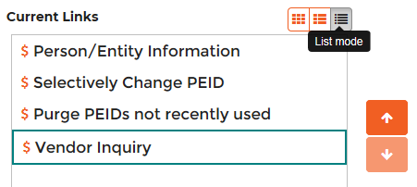
Creating and Modifying Workspaces
Icons in the Current Links pane can be displayed in different formats:
Tile Mode (Default mode)
Tile Mode with mask
List Mode
The order of icons in the pane can also be changed using the up and down arrows.
Select the item in the pane to be moved and use the arrow keys to move it up or down.

Slide 39
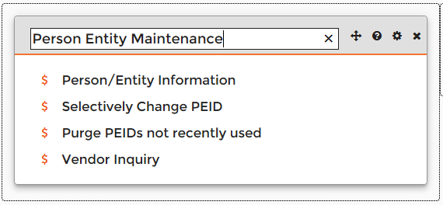
Creating and Modifying Workspaces
After saving the changes the links will be displayed on the desktop in the order and format they were saved in.
The component containing the links does not contain a name.
To add a name to the component, click in the name field and enter the desired name.

Slide 40
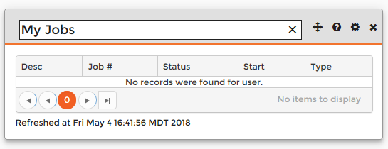
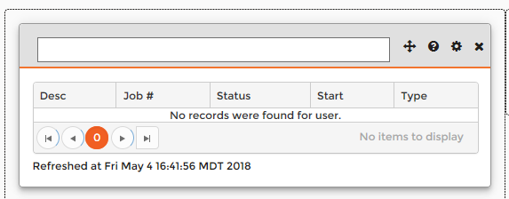
Creating and Modifying Workspaces
Adding a Jobs Component
After selecting the My Jobs component in the Add Component window, click on the Add Button.
The My Jobs component will be added to the frame on the desktop.
Enter a name for the component in the name field of the component.

Slide 41
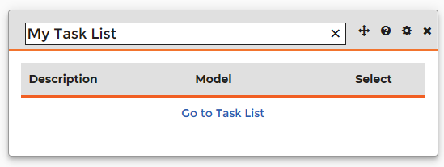
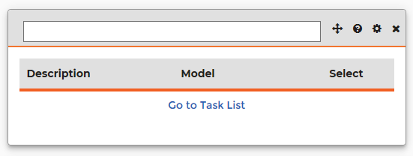
Creating and Modifying Workspaces
Adding a My Tasks Component
After selecting the My Task component in the Add Component window, click on the Add Button.
The My Task component will be added to the frame on the desktop.
Enter a name for the component in the name field of the component.

Slide 42
Creating and Modifying Workspaces
Each component has a toolbar with the following elements:
Move
A tool tip that explains the component’s use
Configure – Does not do anything on the Jobs and Task List components but allows for editing on the Links components.
Remove – Deletes the component

Slide 43
Creating and Modifying Workspaces
Moving a component
To move a component to another location in the Task Center, hover the mouse pointer over the Move button in the component’s tool bar.
The mouse pointer will change to display a white cross symbol.
Click and hold the left mouse button and the component will become dimmed and allow the component to be dragged to the new location.
Release the mouse button to drop the component in the new location as shown on the next slide.

Slide 44
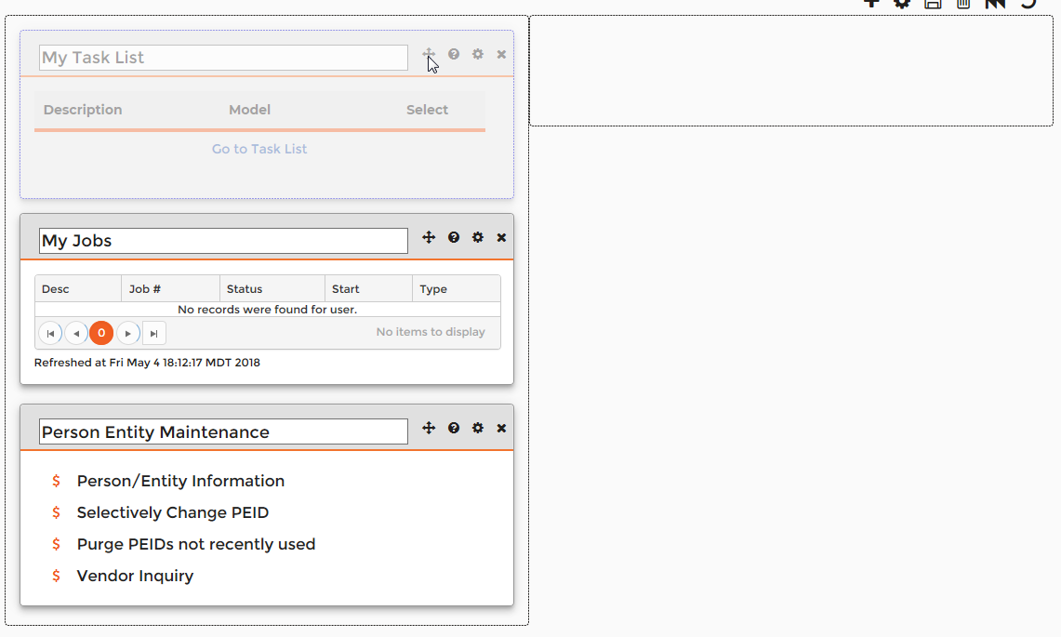
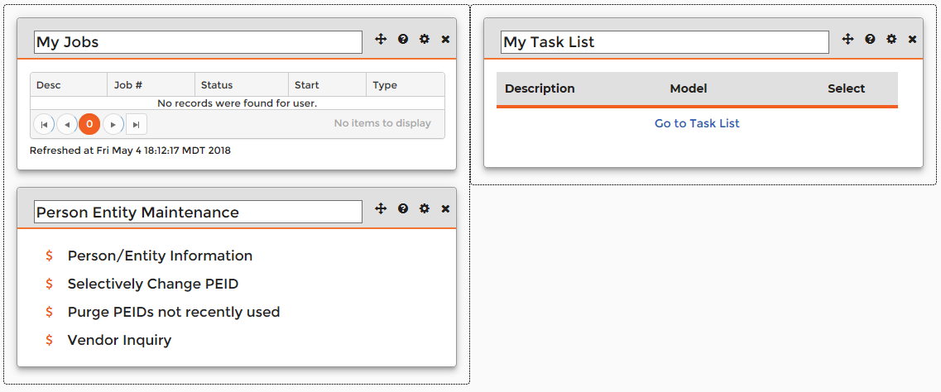
Creating and Modifying Workspaces

Slide 45
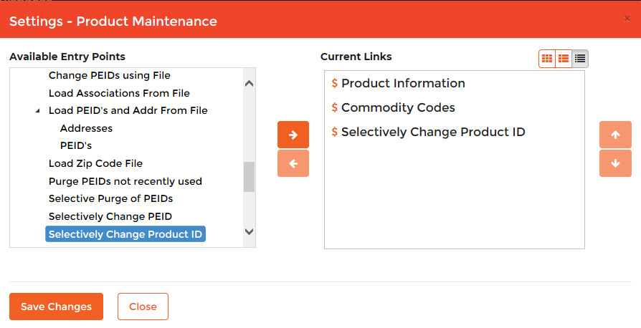
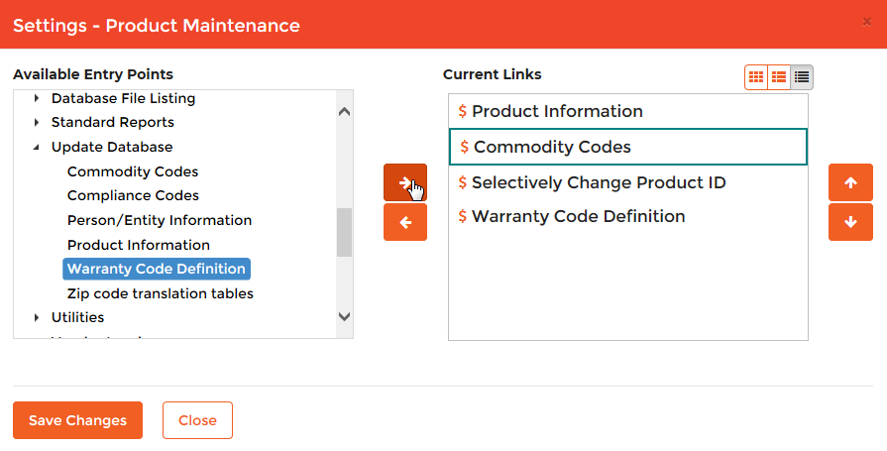
Creating and Modifying Workspaces
Editing a Links component
Click on the Configure tool in the components tool bar.
A Settings window will open for the component and allow you to make changes such as adding new links, removing links, and moving links up or down in the list.
Click the Save Changes button to save the changes made.

Slide 46
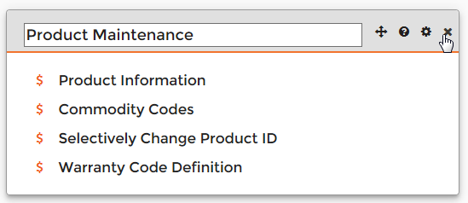
Creating and Modifying Workspaces
Deleting a component
Click on the Remove tool in the component’s tool bar.
A Remove Component window will open to confirm that you really want to delete the component.
Click the Remove Component button to confirm that the component should be deleted.
The component will then be removed from the Task Panel

Slide 47
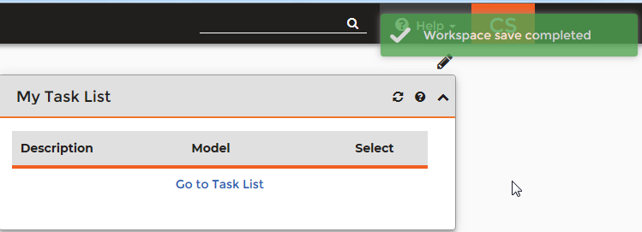
Creating and Modifying Workspaces
Saving Your Workspace
After you have finished making any changes to your workspace it must be saved to make the changes permanent.
To save the workspace, click on the disk icon in the workspace toolbar.
A green message will display in the top right corner of the screen to indicate that the “Workspace save completed.”
The Workspace toolbar will also be replaced by a pencil icon.

Slide 48
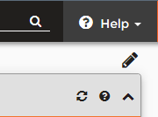
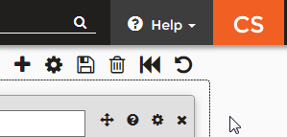
Creating and Modifying Workspaces
Modify an existing Task Center
Select the Task Center from the workspace’s Task Center list.
Click on the pencil icon in the Task Center toolbar.
The Task Center toolbar will change to display the full array of toolbar elements.
Click on the Edit Page Details tool to reopen the Task Center Details window.
Make any necessary changes to the Task Center Title or Layout configuration and then click the OK button to close the window.
Click the Disk icon to save the changes made.
A message will display indicating the save completed.

Slide 49
Creating and Modifying Workspaces
Deleting an existing Task Center
Select the Task Center from the workspace’s Task Center list.
Click on the pencil icon in the Task Center toolbar.
The Task Center toolbar will change to display the full array of toolbar elements.
Click on the Delete Task Center tool to delete the Task Center.
A Delete Task Center window will display asking if you want to delete the Task Center.
Click the Delete button to confirm the deletion.

Slide 50
Conclusion
During this breakout session the following topics were covered:
Workspaces Overview
General Oveview
Features Description
Navigation in the ONESolution Workspaces
Top Banner
Using the Search field
Accessing Help Documents
Viewing User Profile
Changing Passwords
Viewing Notifications
Navigation Panel
Workspaces Node
Task Nodes
Main Menu

Slide 51
Conclusion
During this breakout session the following topics were covered:
Creating and Modifying Workspaces
Workspaces Designer Overview
Advanced Options menu
Adding a new workspace
Modifying an existing workspace
Deleting an existing workspace
Creating a New Task Center
Adding a new Component (Cognos, Links, My Jobs, My Tasks)
Moving a component
Editing a Links component
Deleting a component
Saving Your Workspace
Modify an existing Task Center
Deleting an existing Task Center

Slide 52
Questions?

Slide 53
Thank You
Thank you for attending this breakout session.
I hope you found it helpful.
cassandra.shrum@superion.com

