Slide 1
County of Imperial BAR, Fixed Assets and Purchasing Presentation

Slide 2
BARs (Budget Amendment Resolutions)
Fixed Assets
Purchasing Procedures

Slide 3
Budget Amendment Resolutions (BARs)
What are Budget Amendment Resolutions
(BARs)?
Budget Amendment Resolutions (BARs) are budget adjustments that require Board Approval.
BARs are used only after the budget has been adopted and only through June 30th of the fiscal year for which it applies.

Slide 4
Budget Amendment Resolutions (BARs)
What are BARs used for?
BARs are used only to make changes to the adopted budget due to:
An increase in funding or for the recognition of additional funding from grants or programs, i.e. State, Federal, or other sources
The purchase of fixed assets
The use of the fund balance to increase or create appropriation(s) availability
The transfer of funds between budget units
A decrease in a budgeted funding level
An increase in Out-of-County Travel Expenditures (Pending Board Approval).

Slide 5
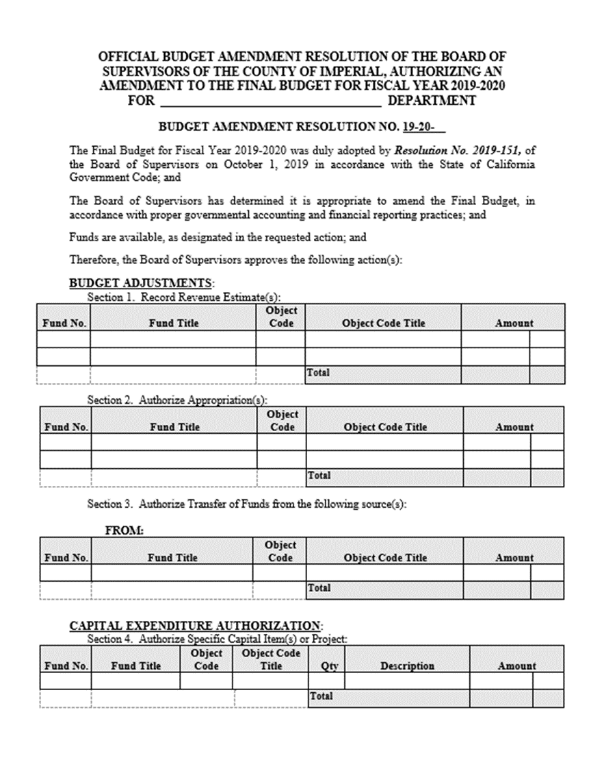
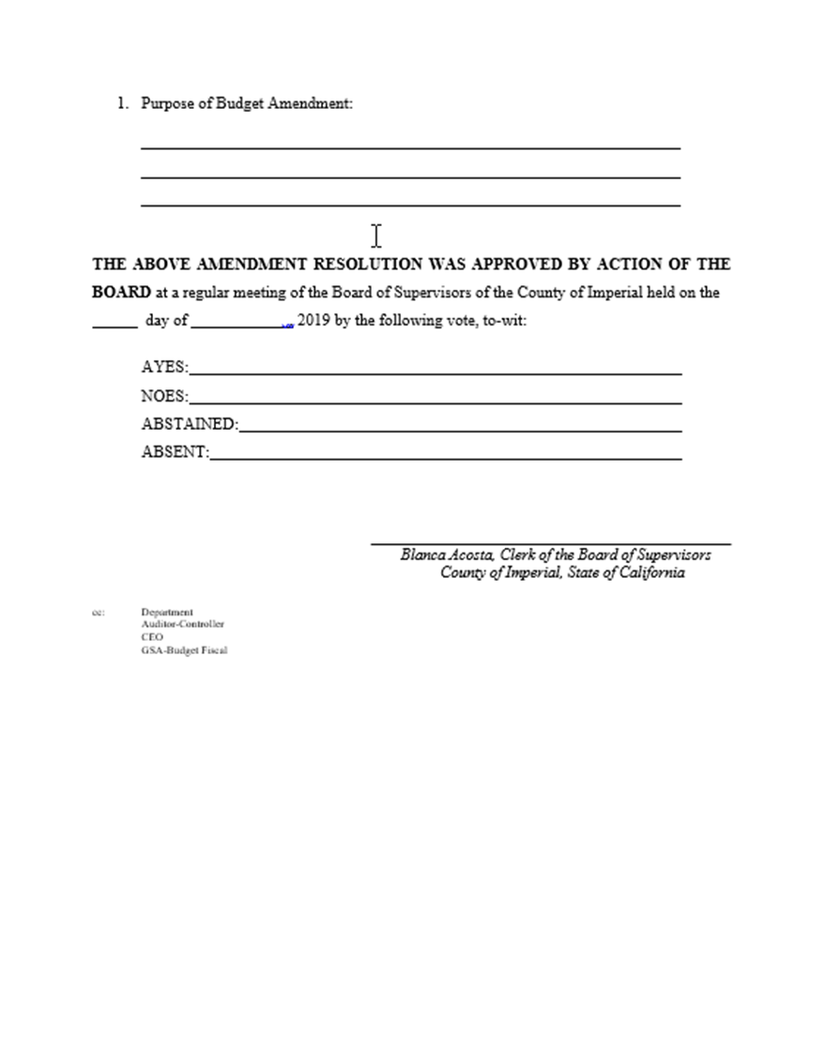
What does a BAR look like?

Slide 6
Budget Amendment Resolutions (BARs)
Where can I find the BAR form?
The annual BAR form is usually emailed by Clerk of the Board once the budget has been adopted.
You can also download the form from Clerk of the Board’s website under the forms section:
https://www.co.imperial.ca.us/BoardSuperv/index.asp?fileinc=clerkforms

Slide 7
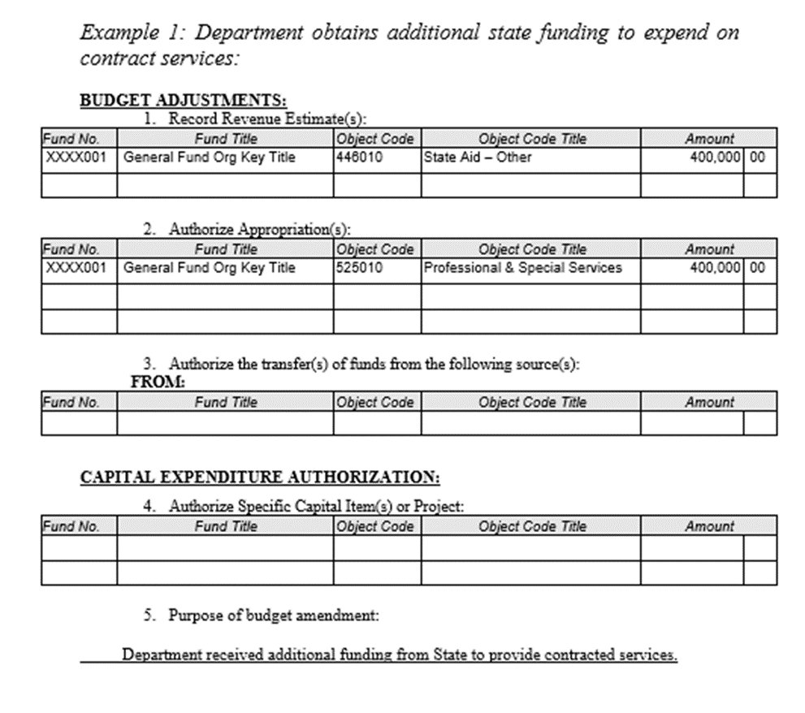
EXAMPLES OF BARs
Department obtains additional State funding for contracted services

Slide 8
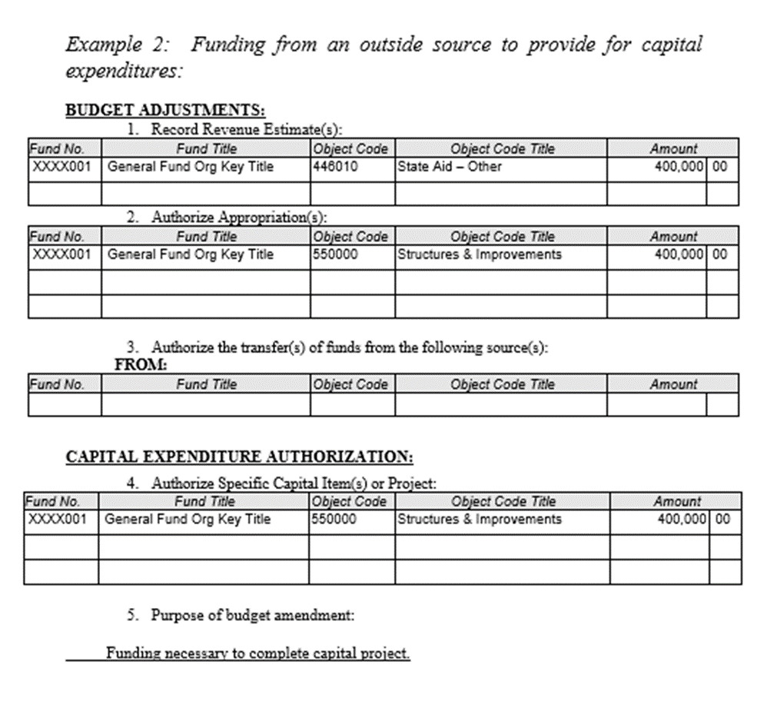
EXAMPLES OF BARs
Funding from an outside source to provide for capital expenditures

Slide 9
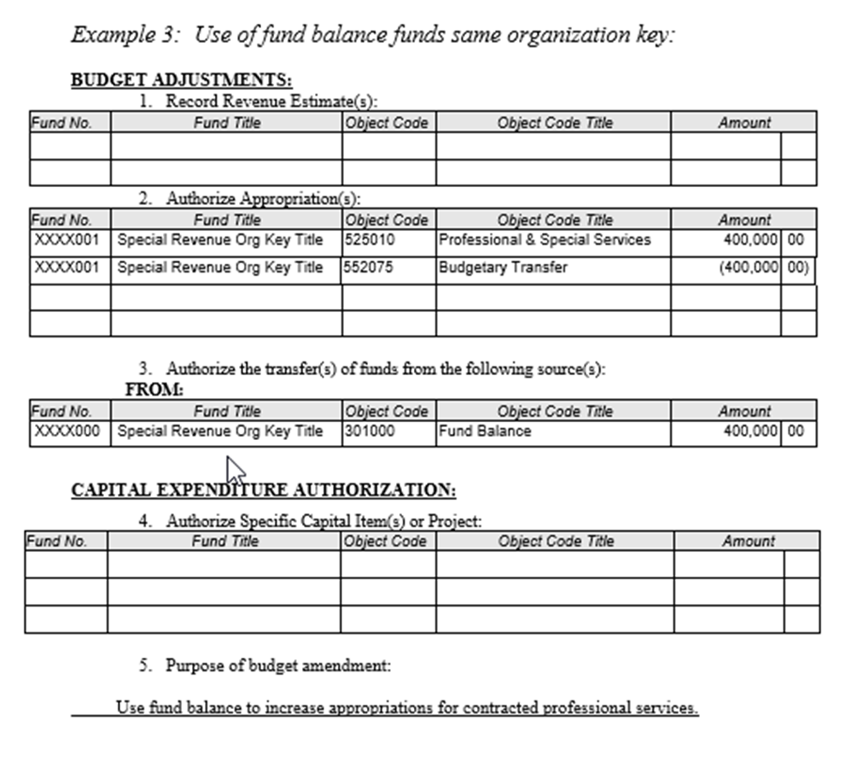
EXAMPLES OF BARs
Use of fund balance to increase appropriations within same org key

Slide 10
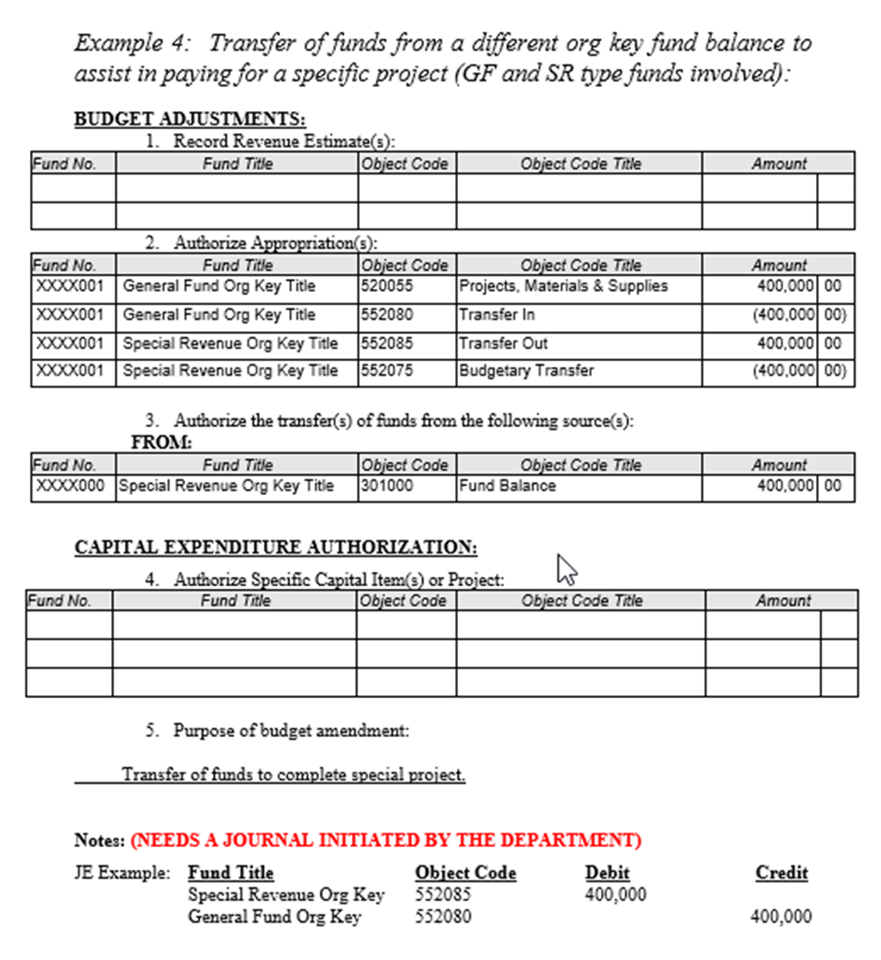
EXAMPLES OF BARs
Transfer funds from different org keys for a specific project

Slide 11
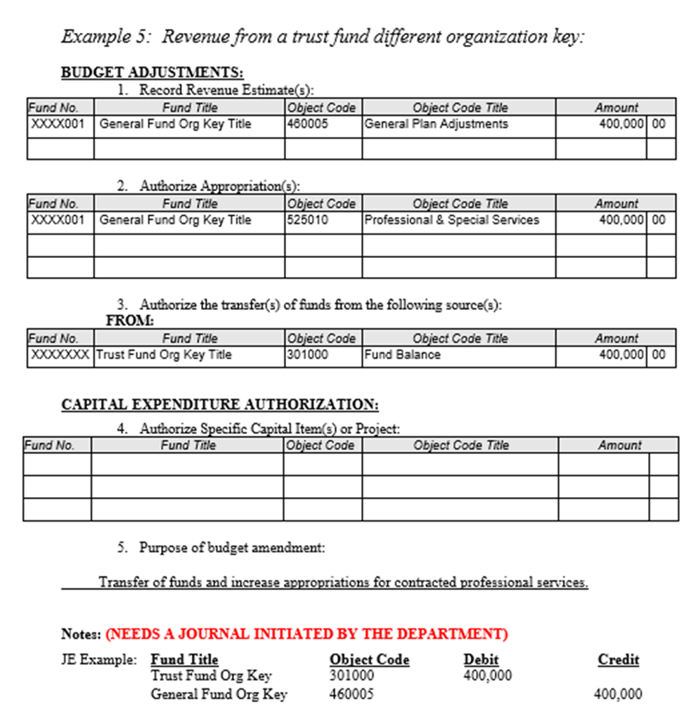
EXAMPLES OF BARs
Receiving revenue from a Trust Fund

Slide 12
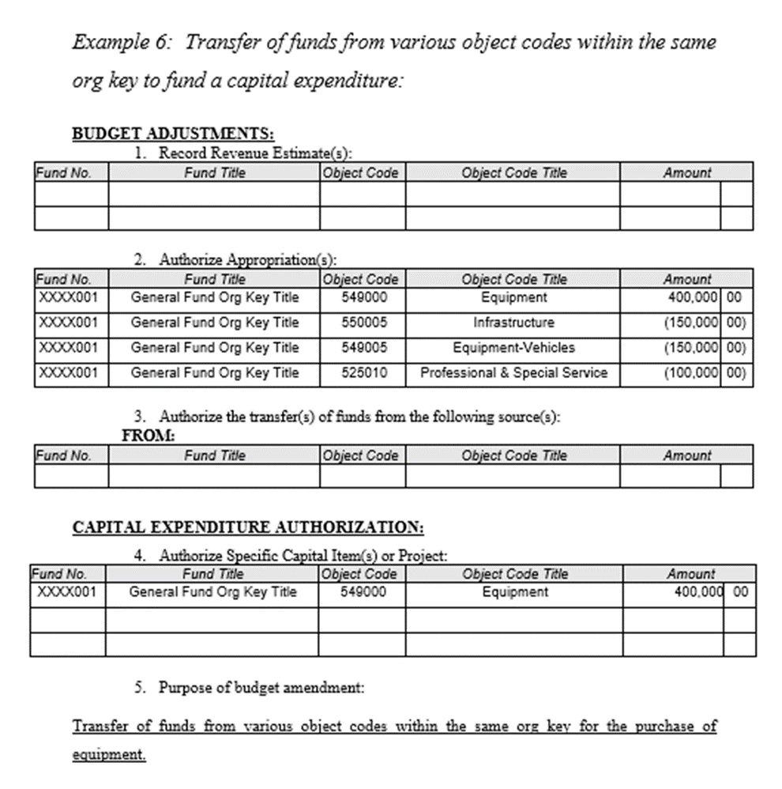
EXAMPLES OF BARs
Transfer funds from various object codes in one org key for capital project

Slide 13
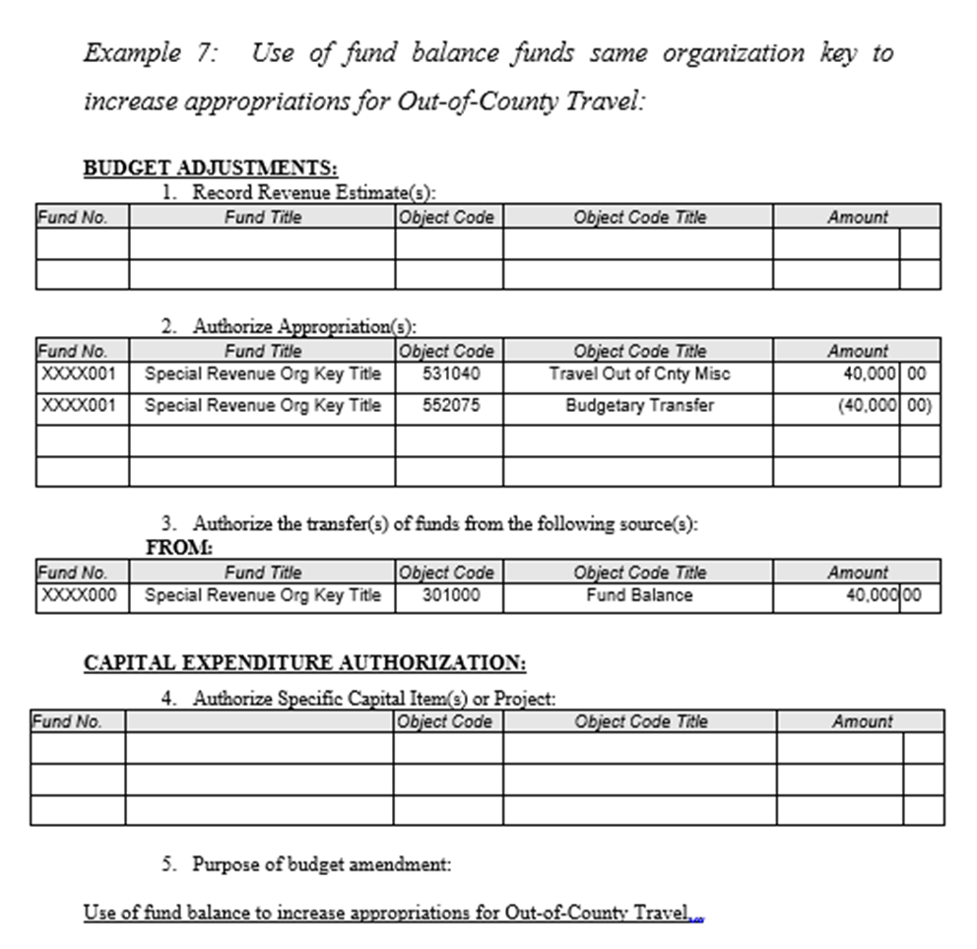
EXAMPLES OF BARs
To increase appropriations for Out-of-County Travel (pending Board Approval)

Slide 14
Other BAR Notes…
Auditor’s office inputs budget adjustments upon receipt of a copy of the approved BAR from Clerk of the Board. If your BAR has not been posted please deliver or email a copy of the approved BAR to the Auditor’s Office for posting.
Make sure you submit an encumbrance form to CEO/GSA if you will be using funds from an approved BAR into the next fiscal year as budget adjustments do not roll over.
Pending Board Approval – all budget adjustments to increase Out-of-County Travel will require Board Approval via a BAR.

Slide 15
Questions?

Slide 16
Fixed Assets
What is a fixed asset?
“Assets used in operations that benefit more than a single fiscal period”
2019
2020

Slide 17
Fixed Assets
Different categories
549000 – Equipment
549005 – Vehicles
549010 – Equipment Info Technology
549015 – Firearms
550000 – Structures & Improvements
550020 – Construction

Slide 18
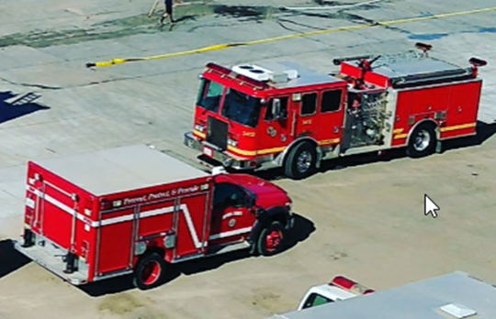
Equipment (549000)
What is considered equipment?
Machines
Tools
Furniture
Heavy Machinery
Workstations
Off-Road Vehicles
Fire Trucks

Slide 19
Equipment Threshold amount
How much can we spend?
$7,500

Slide 20
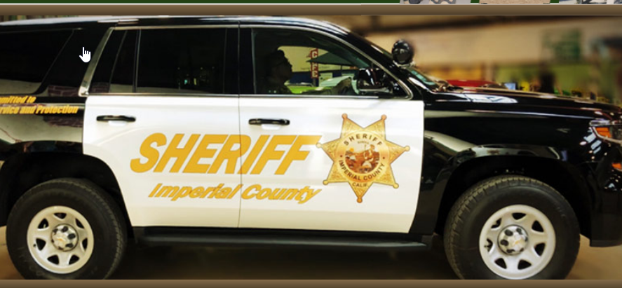
Equipment – Vehicles (549005)
What is considered equipment - vehicles?
All County Vehicles
Safety Vehicles

Slide 21
Equipment - IT (549010)
What is considered Equipment - IT (Information Technology)?
Servers
Processors
Computer Software
Computers
Routers

Slide 22
Equipment IT Threshold amount
How much can we spend?
$7,500 (Equipment for IT)
and
$25,000 (Computer Software only)

Slide 23
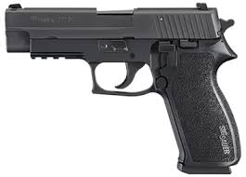
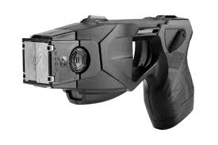
Equipment - Firearms (549015)
What is considered Equipment Firearms?
Tasers
Guns
Rifles

Slide 24
Equipment Firearms Threshold amount
How much can we spend?
ALL weapons must be capitalized
No minimum

Slide 25
Exceptions for equipment
“Groups of like designated assets individually less than $7,500, the cost of which in the aggregate exceeds $50,000 and are purchased under a program for installation over a period of time, are to be capitalized”

Slide 26
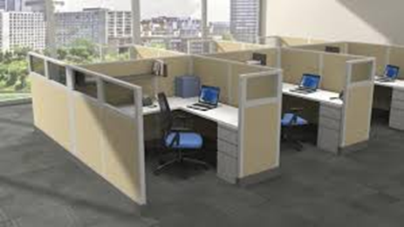
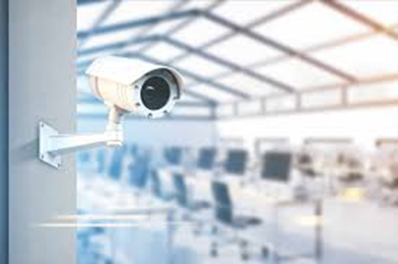
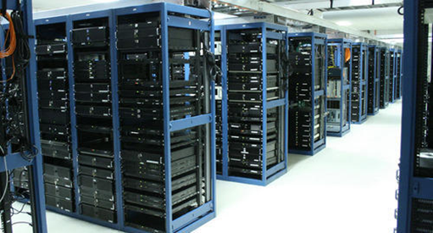
Examples of fixed assets
Items that are bought in a group that would be considered a fixed asset

Slide 27
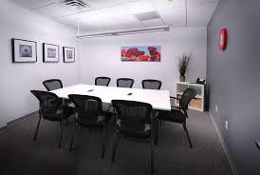
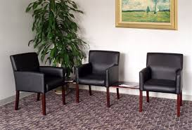
Examples of non-fixed assets
Items that are bought in a group, but not considered a fixed asset

Slide 28
Other Equipment Notes…
If its not fixed assets, must be coded to:
Office Expenses (524000)
Special Department Expense (530005)
Office Expense Furniture (524045)
Or other appropriate object codes
Installation costs of equipment are capitalized as well

Slide 29
Structures & Improvements (550000)
What is considered Structures & Improvements?
Additions or betterments to existing buildings that are not readily moveable
A betterment is defined as an expenditure having the effect of upgrading an existing asset

Slide 30
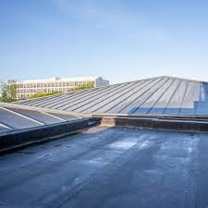
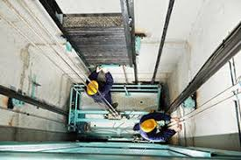
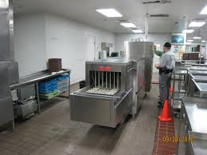
Examples of Structures & Improvements
Office and building remodels
Elevator improvements
Air conditioning system for building
Water storage tanks
Roofing projects

Slide 31
S&I Threshold amount
How much can we spend?
$50,000
(minimum)

Slide 32
Other S&I Notes…
Additional costs that are capitalized with Structures & Improvements are:
Purchase price of construction costs
Fixtures attached to the structure
Architect fees
Insurance during construction
Fees and permits
Accident or injury costs
Improvements or betterment costs that are not fixed assets, should be Maintenance (520000)
Pool patch up work
Painting

Slide 33
Construction (550020)
What is Construction?
Construction or also known as CIP (Construction in Progress) or Capital Projects is the “building of something, typically a structure”
Construction costs are recorded under CIP and once completed, they are moved to Structures & Improvements

Slide 34
Examples of Construction

Slide 35
Other Construction Notes…
Other costs that are capitalized with Construction are:
Direct labor
Materials
Equipment usage
Overhead

Slide 36
Other Fixed Asset Notes…
A PTR (Property Transfer Request) form must be filled out to transfer ANY fixed asset from one department to another, auctioned, destroyed and disposed of
Grant programs override County Capitalization policies, unless the County Capitalization policies are lower
General Statement of Fixed Assets are distributed every year, should be thoroughly checked and signed off

Slide 37
Fixed asset Guides
Where can I find forms or guides pertaining to Fixed Assets?
You can find the forms and guides by going on the County of Imperial website:
Under the Auditor-Controller Department
Click on Documents & Forms
Look for Policies & Procedures
https://www.co.imperial.ca.us/Auditor-Controller/index.asp?fileinc=procedures

Slide 38
Questions??

Slide 39
purchasing
Prior Year Encumbrance: (PY Purchase Orders)
Review PY ensure funds are available and know the purpose of PY encumbrance
Category does not match with PY description
PR Notes
Liquidate PY
Do not process payment request (claim) with PY number

Slide 40
Purchasing
Prior Year Encumbrance: (PY Purchase Orders)
Funds available
Minute Order documents (MO number and date of Board approval) – Must be attached to the PR
Attachments:
Attach supporting documentation

Slide 41
Questions??

