Slide 1
Fiscal Year End 20-21
Deadlines,
Requirements,
Forms
Presented by: Auditor’s Office & Purchasing

Slide 2
Year End & Journal Entry Transfers Training June 3, 2021
Agenda
Deposits
Accounts Receivable
Claims
Encumbrances
Purchase Orders
Authorized Signature List
New User Request Form
ONESolution Security Request Form
Schedule of Federal Financial Assistance
Supplies Inventory
Fixed Assets
Journal Entry Transfers
Purchasing

Slide 3
Deposits
Deadline for ALL departments to turn in deposits to the County Treasurer:
Wednesday, June 30, 2021 @ 12 noon

Slide 4
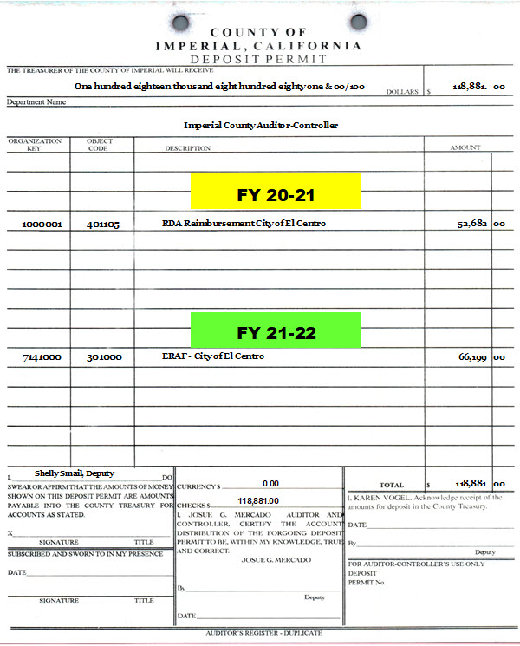
Deposits
Example of how deposit permits should indicate which FY revenue belongs to.

Slide 5
Accounts Receivable
All receivables existing at June 30th, where the cash will not be received on or before July 9th, should be reported to the Auditor’s Office.
Methods of reporting receivables:
By memo. Prepared memo must include:
Organization Key
Object Code
Amount Expected to be Received
On July deposit permits (until July 9th).
Make sure all accounts receivable reported by memo to the Auditor’s Office is not duplicated by reporting the same revenue as prior year revenue on your deposit permits.
The Auditor’s Office will set up the receivables as a credit to revenue in the ledgers at June 30th, and reverse the entries in the July 2021 ledgers.

Slide 6
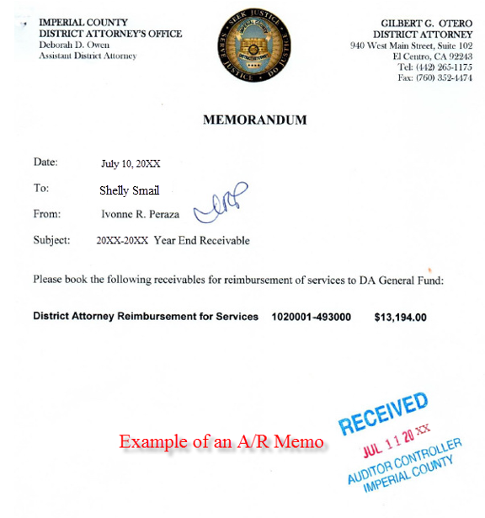
Accounts Receivable (cont’d)
Example of how to request the booking of an Accounts Receivable via a Memo.
All accounts receivable memos should be sent to Shelly Smail’s attention.

Slide 7
Accounts Receivable (cont’d)
Example of how receivables are recorded in the ledgers and reversed.

Slide 8
Claims
Deadline for ALL departments to submit prior year claims to the Auditor Controller’s Office:
Friday, July 9, 2021 @ noon.
Note: No claims will be accepted for processing after 12:00 PM. No Exceptions.
New Audit Requirement: From July 1st through September 30th any Prior Year 20-21 claims submitted for payment in FY 21-22 should be clearly marked in RED:
P 20-21 on the upper right hand corner
FY 20-21 in the description
From July 1st through July 10th any current FY 21-22 claims submitted for payment should be clearly marked in RED:
C 21-22 on the upper right hand corner
FY 21-22 in the description

Slide 9
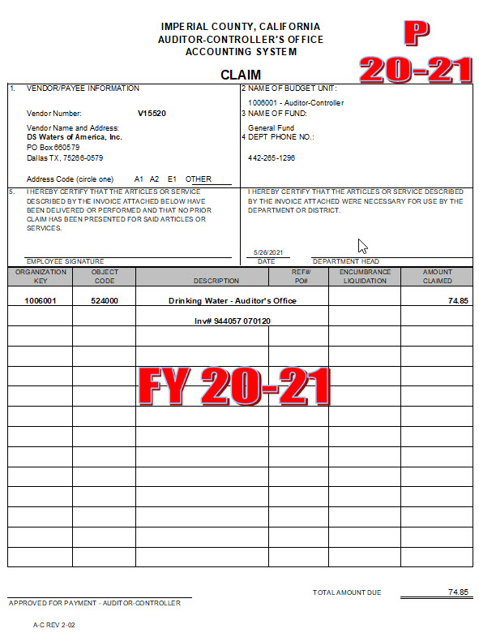
Claims (cont’d)
Example

Slide 10
Encumbrances
What is an Encumbrance?
A commitment to expend resources, such as purchase orders and signed contracts for the purchase of goods and services to be received in the future.
An encumbrance does not represent an expenditure in the current period, but only a commitment to expend funds.
Year End Encumbrances are treated as reserves, meaning the funds are set aside for future expenditure.
Encumbrances:
Must be justified by a contract or minute order.
Encumbrance Request must be submitted to CEO/GSA’s office for approval by June 18th.
Instructions on how to complete Year-End Encumbrance Requests are found in the budget manual on Imperial County’s Intranet page under the Budget Docs & Forms section.
Below is the link to the year-end encumbrance request form.
https://intranet.imperialcounty.org/wp-content/uploads/2021/02/Encumbrance-Form-1.pdf

Slide 11
Encumbrances (cont’d)
Purchase Orders:
All purchase orders will be cancelled unless there is a contract or approved justification that has been submitted to GSA via a PY request.

Slide 12
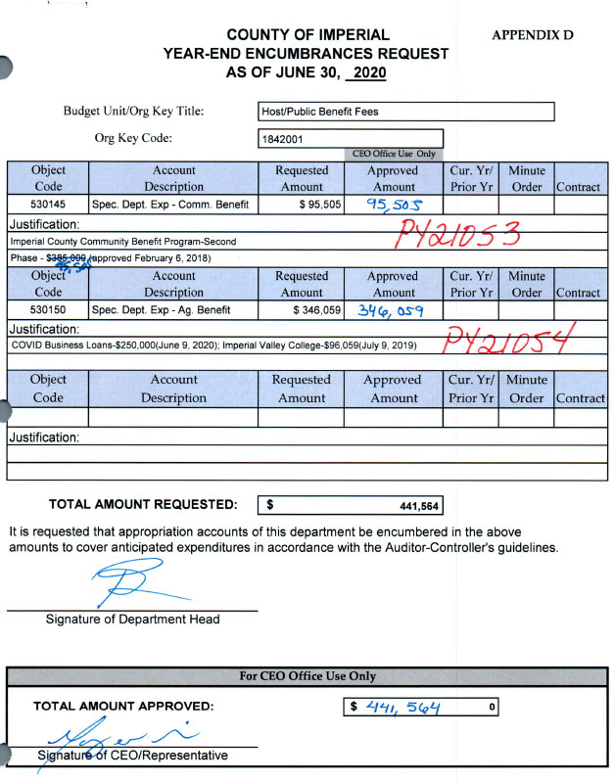
Encumbrances (cont’d)
Example of Backup

Slide 13
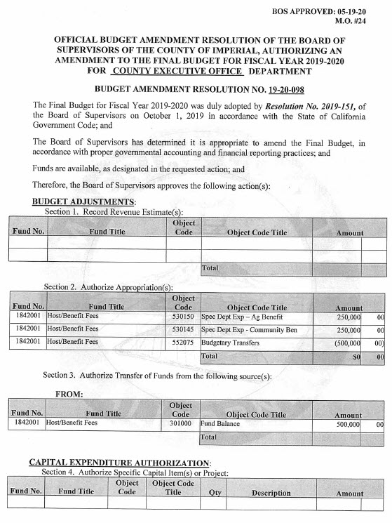
Encumbrances (cont’d)
Example of Backup

Slide 14
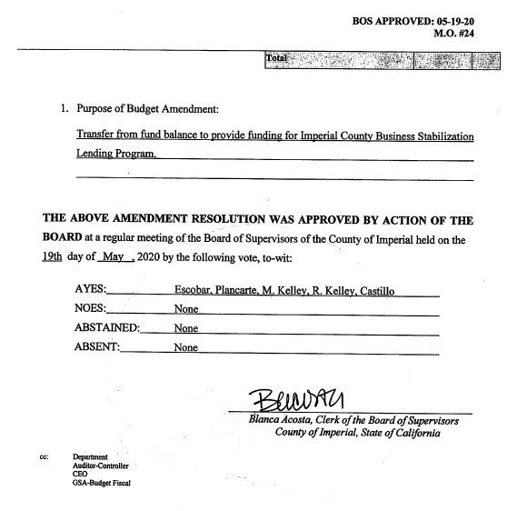
Encumbrances (cont’d)
Example of Backup

Slide 15
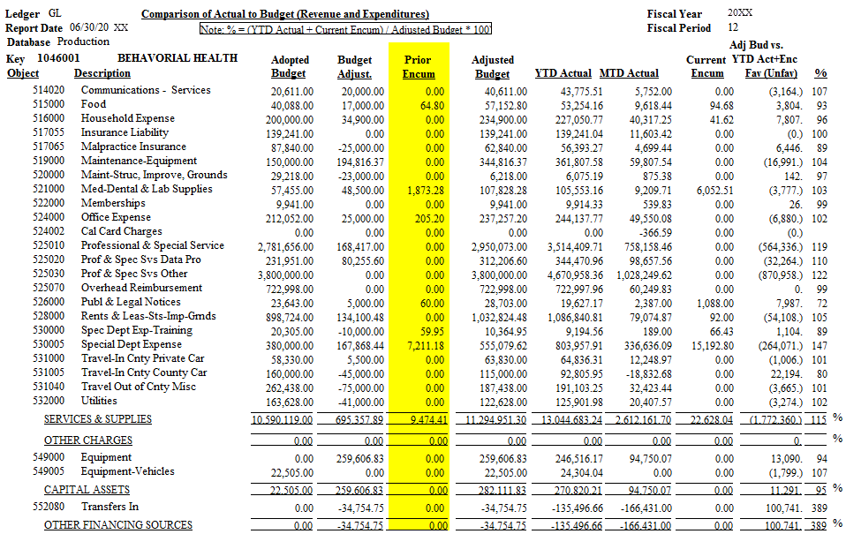
Encumbrances (cont’d)
Example of how prior year
encumbrances appear in the budget

Slide 16
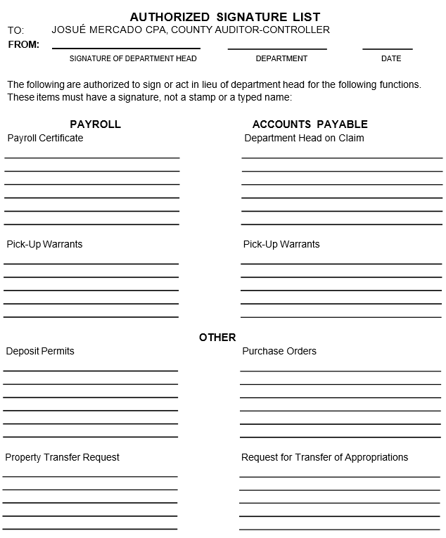
Authorized Signature List
Must be submitted to Auditor-Controller’s Office
by June 30, 2021.
Please type name, then sign.

Slide 17
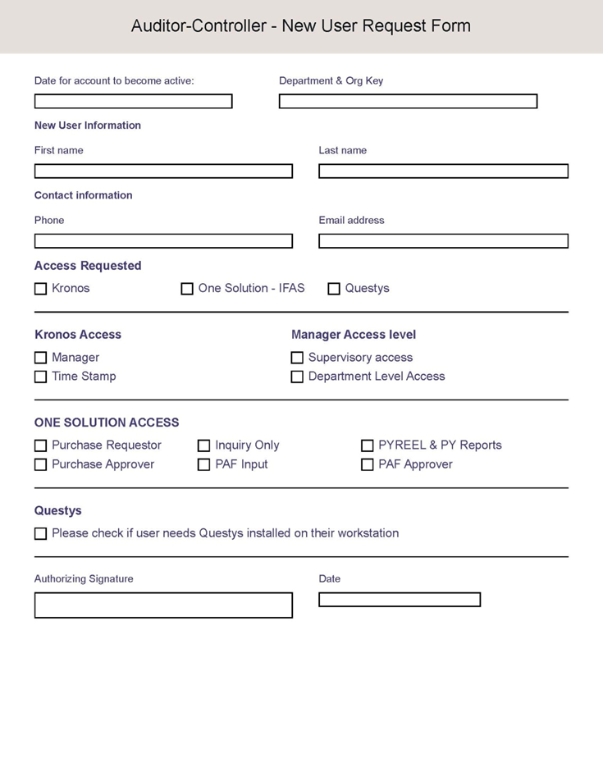
New User Request Form
All New User Request Forms should be sent to Vanessa Castañeda’s attention.

Slide 18
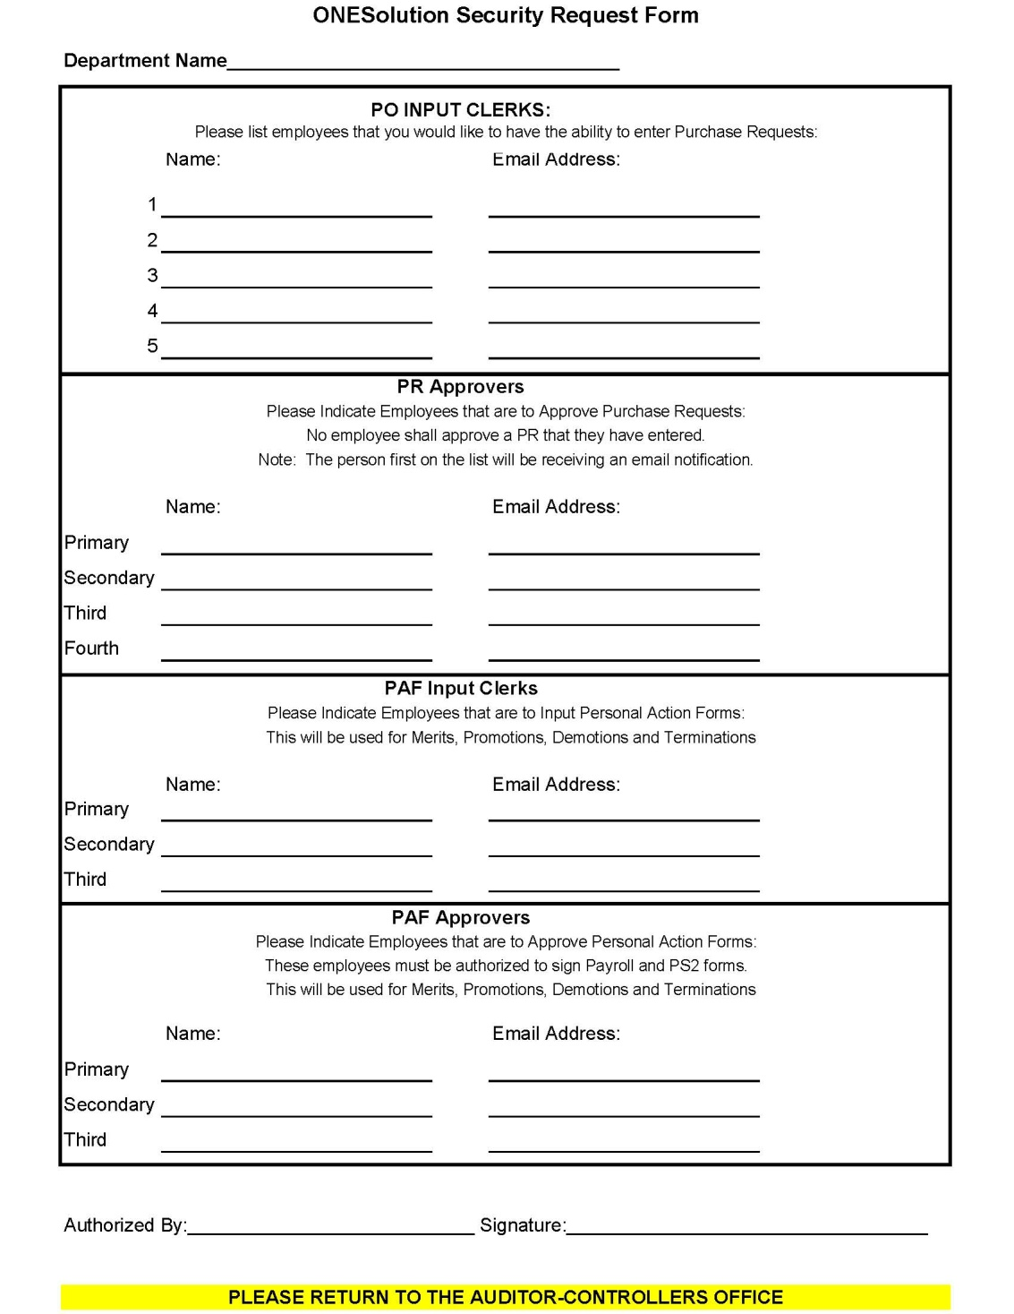
ONESolution Security
Request Form
All ONESolution Security Request Forms should be sent to Vanessa Castañeda’s attention.

Slide 19
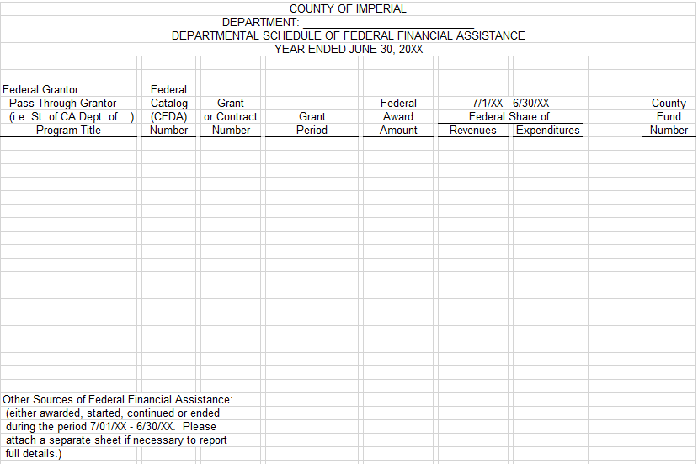
Schedule of
Federal Financial Assistance
The Schedule of Federal Financial Assistance must be submitted to Ivonne Ramirez’s attention
by August 1, 2021.

Slide 20
Supplies Inventory
Deadline for applicable departments to submit the year end Supplies Inventory to the
Auditor Controller’s Office:
Friday, July 2, 2021
The Supply Inventory should be sent to
Vanessa Castañeda’s attention.
Applicable Departments Include:
Behavior Health
Facilities Management
Fleet Services (Garage)
Public Health
Probation
Public Works
Purchasing
Sheriff

Slide 21
Fixed Assets
Deadline for Statement of General Fixed Assets FY 20-21
PTR Form (Property Transfer Request)
Fixed Asset object codes

Slide 22
Statement of General Fixed Assets
Statement of General Fixed Assets will be sent out to Departments no later than June 21, 2021
Deadline for Fixed Asset Inventory Certificate is July 9, 2021
The Fixed Asset Inventory Certificate along with any backup should be submitted to Melissa Caloca
by July 9, 2021.

Slide 23
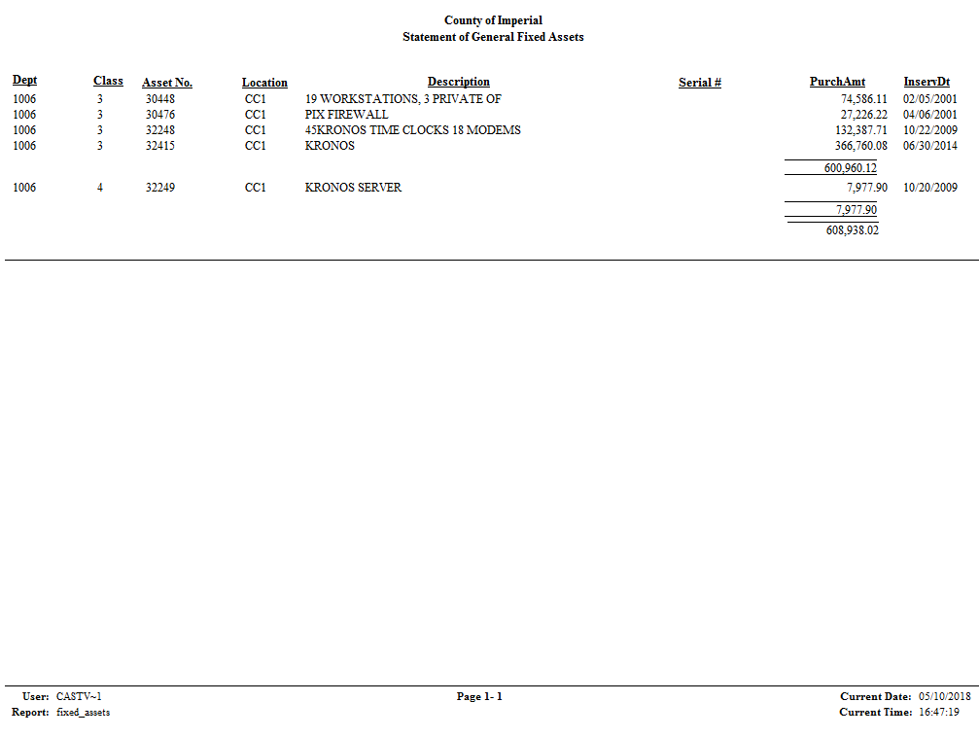
Statement of General Fixed Assets

Slide 24
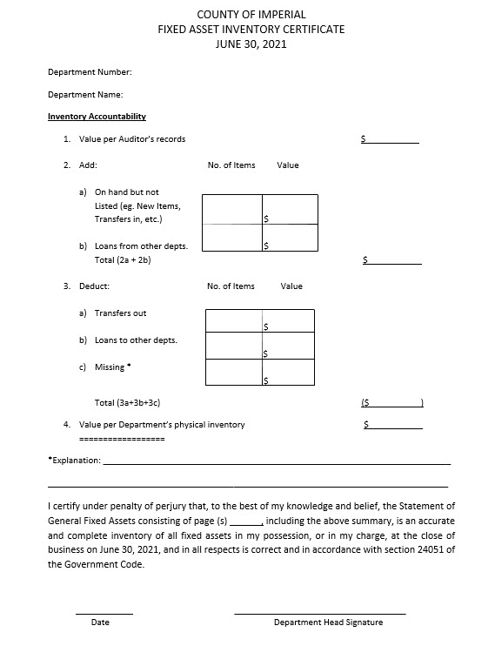
Statement of General Fixed Assets

Slide 25
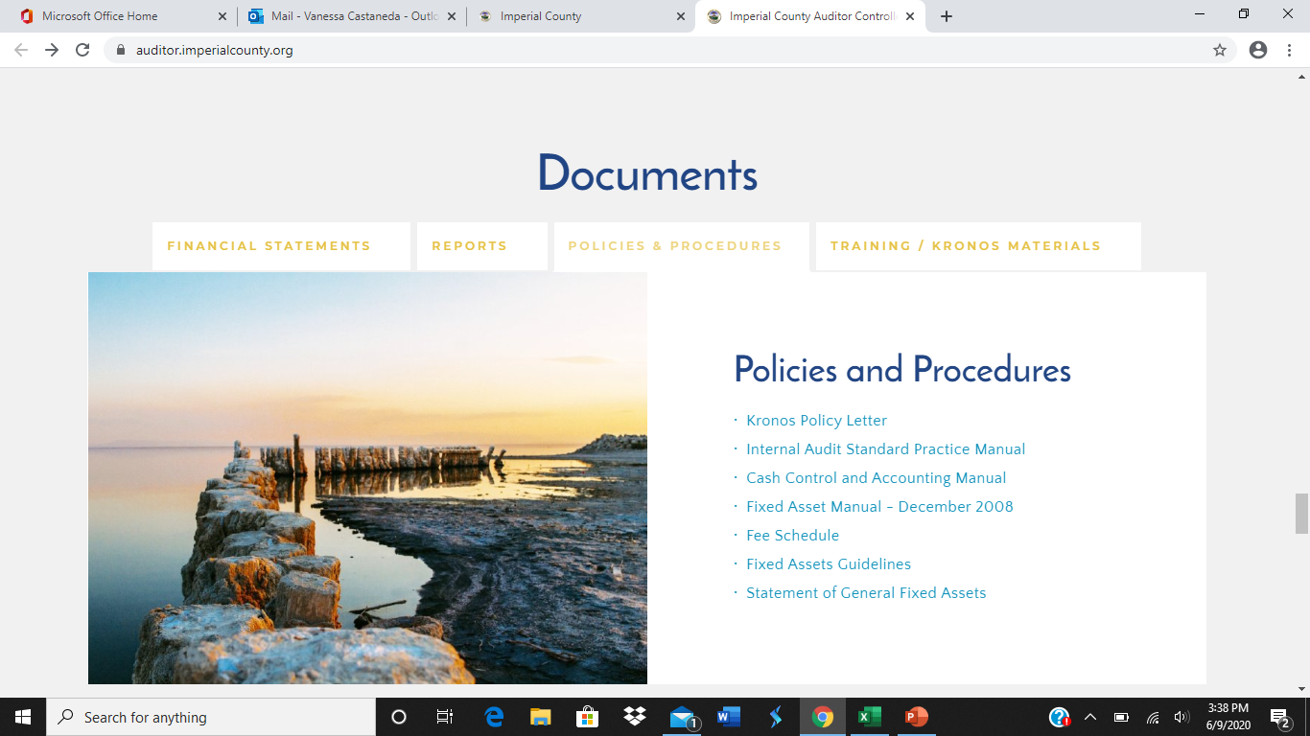
Statement of General Fixed Assets

Slide 26
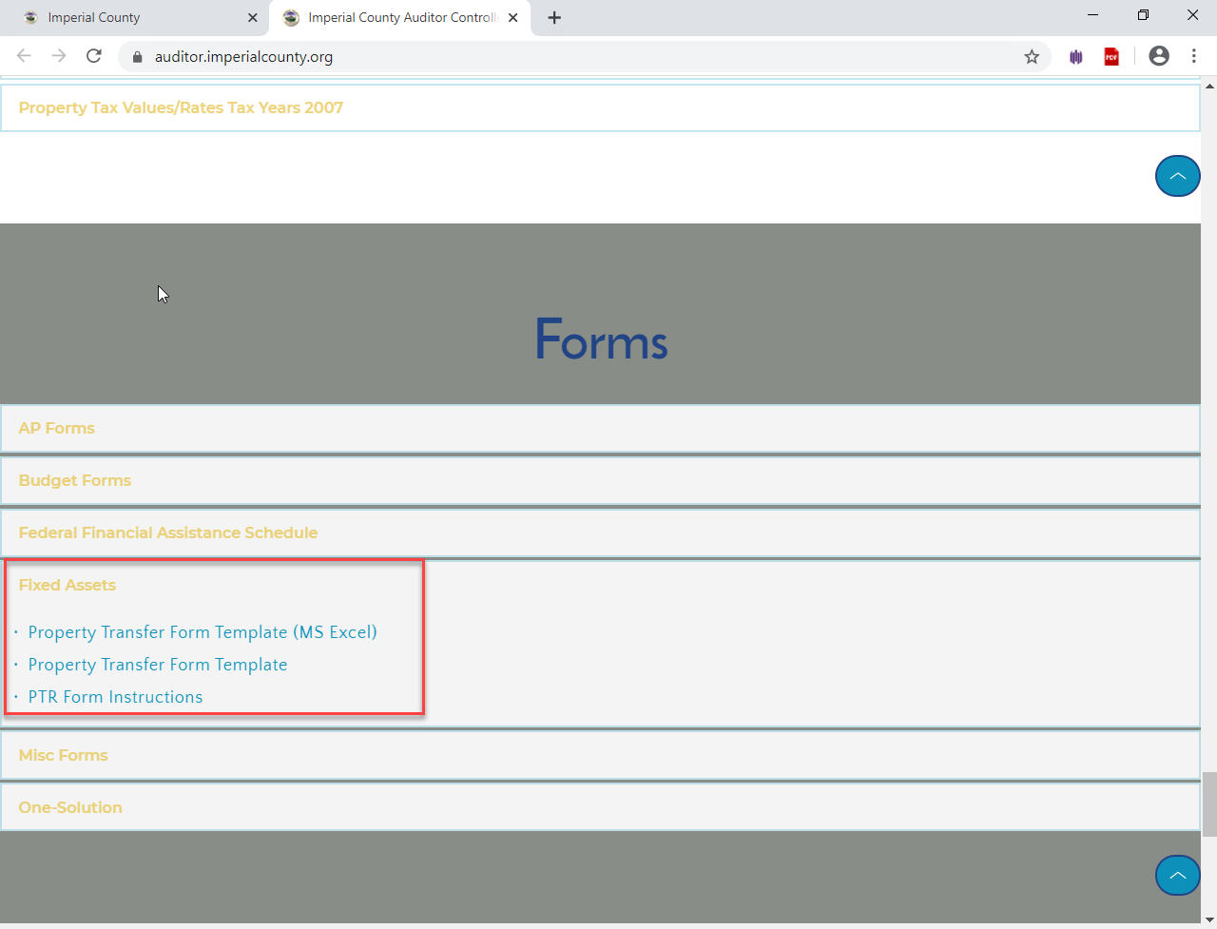
PTR Form
New form is one sheet only, no carbon copies
Available in Excel and Adobe

Slide 27
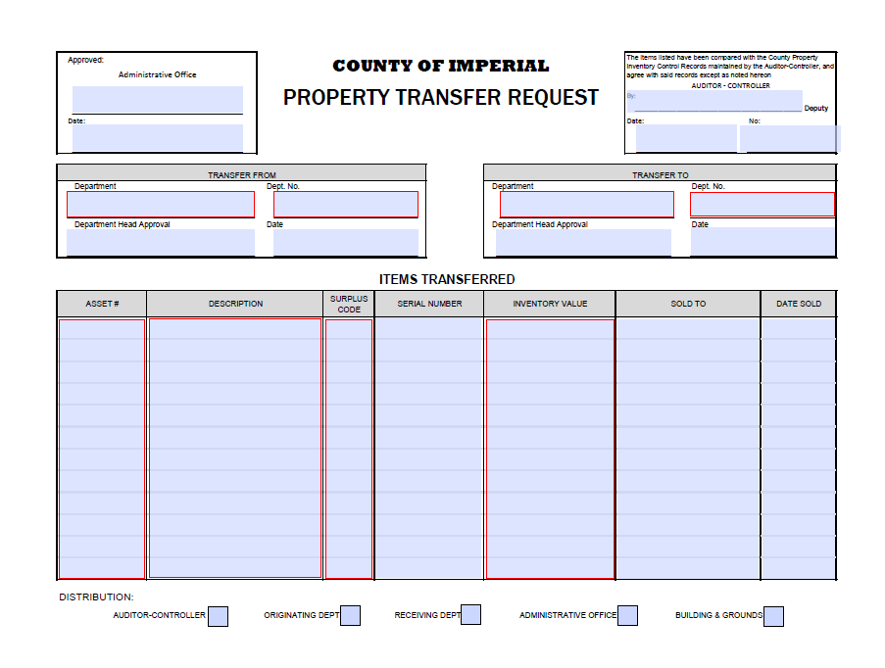
PTR Form
Once the Auditors Office has received the original, copies will be distributed by the Auditors Office to the corresponding departments.
Reminder: Each department has to contact Facilities when transferring assets to Surplus.

Slide 28
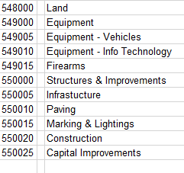
Cheat Sheet on Object Codes for Fixed Assets

Slide 29
Cheat Sheet on Object Codes for Fixed Assets
Equipment (549000) – greater than $7,500.
Weapons (549015) – must be capitalized regardless of amount.
Equipment less than $7,500 but must work together to function - $50,000.
Additions or betterments to existing buildings (550000) - $50,000 min.
Computer software (549010) - $25,000 min.

Slide 30
Journal Entry
Transfers
PROPER OBJECT CODE CLASSIFICATION OF TRANSACTIONS

Slide 31
What are JEs used for?
To transfer the cost of services that county departments provide to one another.(See Cash Control Manual Section 14.11)
To correct a key punch error on a claim, deposit permit, or another JE.
To transfer funds as a result of a Budget Amendment Resolution.
New Audit Requirement: From July 1st through September 30th any Prior Year 20-21 journals submitted in FY 21-22 should be clearly marked in RED:
PY 20-21 in the subject or body of the memo

Slide 32
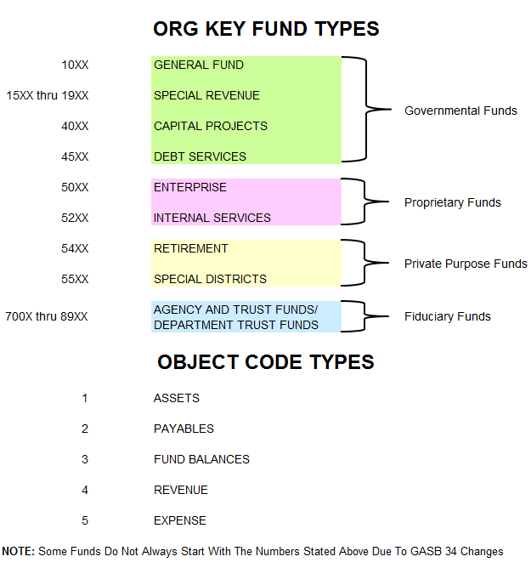
Fund & Object Types:

Slide 33
Org Keys That Are No Longer General Fund And Are Now Considered Special Revenue
1022001 – Child Support
1034001 – Animal Control
1044001 – Public Health
1046001 – Behavioral Health
1047001 – Social Services
1049001 – Categorical Aids
1053001 – California Child Services

Slide 34
Intra-Fund Transfers
Intra-Fund Transfers are transfers between the SAME Governmental Type Funds.
The following line item classifications are allowable:
Object Code | Object Code Title | Debit | Credit
552*** | Intra-Fund Transfer | 100,000
552*** | Intra-Fund Transfer |  | 100,000

Slide 35
Intra-Fund Transfers (Cont’d)
Example #1:
General Fund to General Fund
Sheriff’s Office Reimbursing Auditor’s Office For The Cost of Receipt Books:
Org Key | Object Code | Object Code Title | Debit | Credit
1024001 | 552*** | Intra-Fund Transfer | 11.50
1006001 | 552*** | Intra-Fund Transfer |  | 11.50

Slide 36
Intra-Fund Transfers (Cont’d)
Example #2:
Special Revenue to Special Revenue
The Fire Department reimbursing Public Works for Road Billing Expenses:
Org Key | Object Code | Object Code Title | Debit | Credit
1501001 | 552*** | Intra-Fund Transfer | 8,000.00
1542001 | 552*** | Intra-Fund Transfer |  | 8,000.00

Slide 37
Transfers Between Different Governmental Type Funds
The following line item classifications are allowable:
Object Code | Object Code Title | Debit | Credit
5***** | Expense | 500,000
4***** | Revenue |  | 500,000
Object Code | Object Code Title | Debit | Credit
301000 | Fund Balance | 500,000
4***** | Revenue |  | 500,000
Object Code | Object Code Title | Debit | Credit
552085 | Transfer-Out | 500,000
552080 | Transfer-In |  | 500,000

Slide 38
Transfers Between Different Governmental Type Funds (Cont’d)
Example #1:
Special Revenue to General Fund
Reimbursement to General Fund for Services Provided:
Org Key | Object Code | Object Code Title | Debit | Credit
1556*** | 525010 | Prof & Special Svs | 8,000.00
1002*** | 493000 | Reimb for Services |  | 8,000.00

Slide 39
Transfers Between Different Governmental Type Funds (Cont’d)
Example #2: Trust Fund to Special Revenue
To record revenue from a Trust fund to a Special Revenue or General Fund:
Org Key | Object Code | Object Code Title | Debit | Credit
1225000 | 301000 | Fund Balance | 8,000.00
1847001 | 446010 | State Aid |  | 8,000.00
Note: When transferring from a trust fund, the Org Key must end in 000

Slide 40
Transfers Between Different Governmental Type Funds (Cont’d)
Example #3: Special Revenue to General Fund
Reimbursement from a Special Revenue to a General Fund for pass thru payments and budget transfers:
Org Key | Object Code | Object Code Title | Debit | Credit
1866*** | 552085 | Transfer-Out | 8,000.00
1028*** | 552080 | Transfer-In |  | 8,000.00

Slide 41
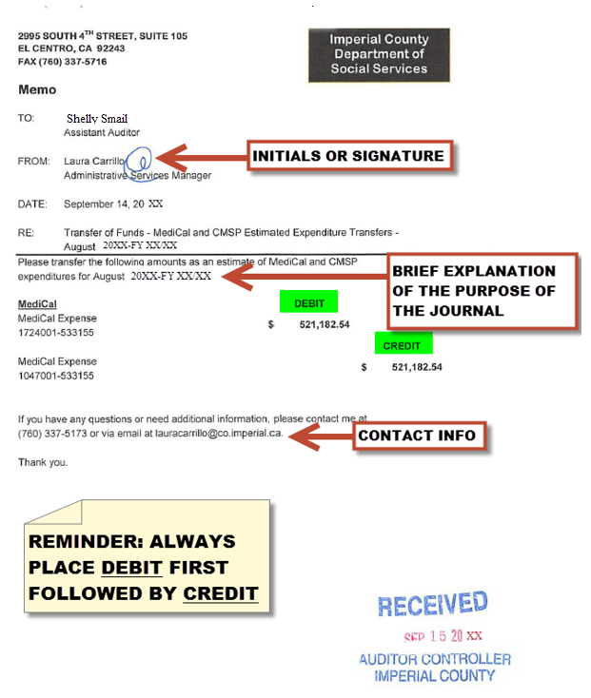
Proper JE Memo Format

Slide 42
PURCHASING YEAR END PROCESSES
PURCHASE REQUESTS – review balances when processing requisitions, if funds are not available it will delay processing time. This is especially important when purchasing late in the year. Purchase Orders will not be issued if funds are not available.
Provide full descriptions
Reminders:
Fixed Assets – must have approved minute order & date. Be sure to attach Board documentation within the system.
We will ask questions for requests that are out of the ordinary, such as shirts, food, boots, canopies – provide as much information up front as possible to avoid delays.
Remit To – if a vendor has a specific address be sure to make the appropriate change
CONFIRMING – (Invoice PO’s) – Confirming invoices have been increasing in numbers. Please try to obtain a PO before purchasing on your own. Confirming should be used only for standard monthly bills and contracts. Departments are not authorized to purchase on their own, please utilize the Procurement Process, you could be putting the County at risk.
Indicate fiscal year (2020/2021)
New Year – indicate fiscal year in description and notes (2021/2022)
Add full descriptions, as much information as possible

Slide 43
PURCHASING YEAR END PROCESSES
CONFIRMING CONTINUED– When submitting invoice payments please include a copy of the invoice and stamp it “COPY” this will allow Auditors to send a copy of the invoice with the warrant.
SUPPLEMENTS – attach backup documentation to support reason for supplement. Example: A copy of an invoice that has shipping charges but the original quote did not.
NOTES: Utilize notes to tell the story.
CDD REPORTS – review reports to identify encumbrances that need to be cancelled or corrected.
Email Procurement to request closing PR’s or PO’s procurement@co.imperial.ca.us
Close as many as possible – to start the new year on a good note.
Prior Year Encumbrance (PY) – Review PY’s for double encumbrance and when making purchases. When using a PY for the new fiscal year indicate the PY number within the description and notes.

Slide 44
PURCHASING YEAR END PROCESSES
Office Depot – various invoices are more than 60 days late (30 Day invoicing), critical to process before July 9th no later than 5:00 PM
When using Office Depot look for best value (green products if possible and practical)
Lump orders together – orders must be $50 minimum
Office Depot blankets (A21) will expire at June 30th. After this date you will not be able to place orders. Submit payments no later than July 9th before 5:00pm.
Blankets – All blankets will expire June 30th after this date no orders or purchases are allowed. Begin entering your new blankets June 7th.

Slide 45
PURCHASING YEAR END PROCESSES
Blankets – Begin entering new blankets June 7th. Be sure to review who will have authority to purchase and use the below standard information:
BLANKET PURCHASE ORDER FOR THE PERIOD OF
JULY 1, 2021 THRU JUNE 30, 2022
(BLANKET PURPOSE)
(AUTHORIZED INDIVIDUALS) – make sure all names are listed
Coping Blankets – ensure the appropriate changes are made and provide as much information as possible
INFORMATION TECHNOLOGY (IT) – for all software/computer equipment (hard drives, monitors, IPad, Laptops, etc.) must obtain approval from IT Manager Henry Felix prior to placing into ONESolution. Include the approval with the attachment backup. If prior approval not receive, it will slow down the PO process.
All software purchases must use Object Key #519055 do not use Special Department Expense (530005) or Office Expense (524000).

Slide 46
PURCHASING YEAR END PROCESSES
Agreements – a sample agreement is required for a RFP for services or commodities or guest speaker engagements please contact County Counsel first. Once sample have been obtained then proceed to enter the requisition and attach the sample agreement.
Cal Cards – Remember CAL CARDS are to be used only for travel & travel related expenses, unless you request other type of purchases from the Purchasing Manager or obtain CEO approval.
New card request – please provide legal name. CAL CARD form is available through Purchasing. Complete form and send to CEO office first, they will forward us the request when approved.
Surplus Items – contact Richard Granados ext. 1874 (main contact) or Venessa Ramirez ext. 1865 (backup contact) to find out if there is room in the quonset hut. Purchasing has a new process and form that is required to be completed. Please contact the department to obtain the new instructions. The new form is located on our website.
Feel free to contact us should you have any questions or need assistance
procurement@co.imperial.ca.us
442-265-1866 (ext.1866)

Slide 47
For any questions please contact the Auditor’s or Purchasing Department.

