Slide 2
The New PO Change Order Process
Making Changes to Purchase Orders using the ONESolution Change Orders
Presented By Cassandra Shrum

Slide 3
Agenda
During this breakout session the following topics will be covered:
Overview of the Change Order Process
System Integration
System Configuration
The Change Order Process

Slide 4
Overview
A General Overview of the Change Order Process

Slide 5
Overview
The PO Change Order process is used to make changes to purchase orders and provide a mechanism for tracking the changes made.
Previous versions of the software required changes to be made to the original purchase order record and the record to be printed to apply the changes.
This method did not provide an easy way to track the changes made.
The new process begins on the PO Change Order screen (POUPCO) where you extract an existing purchase order, create a change order, and make the desired changes.
The change order is then submitted, allowing it to flow through optional approvals in Workflow.
Once approved, the change order is sent to Purchasing and the purchase order is updated.

Slide 6
Overview
Before you can extract a purchase order, it must meet all of the following eligibility requirements:
The order must exist in Purchasing with a status of PO (purchase order) or PP (partial pay).
The Purchase Order number can’t exist in Contract Management (CMUPCM)
You must have access to the security code on the purchase order to create a change order for that PO.
The purchase order can’t be “active” in the change order process. You must complete or delete an active change before the same purchase order can be extracted again.
The purchase order can’t be from PunchOut.

Slide 7
Overview
The Change Order process relies on the following components:
PO Change Order screen (POUPCO)
PO Change Order Send to PO utility (POUTSC)
Purchase Request screen (POUPPR)
PO_Change Workflow model

Slide 8
System Integration
Integration with Purchasing, Workflows, and Documents Online

Slide 9
System Integration
Direct linkage from PO Change Order to POUPPR is provided via the PO change order number, which is present on both screens.
In the PO Change Order Screen (POUPCO), it is the PO Change Order Ref field and in the Purchase Request screen (POUPPR) it is the Change Order Number.
The Purchase Order Change Order screen is fully integrated with Workflow for approvals and notifications.
The screen comes standard with the PO_CHANGE approval model.
The Purchase Order Change Orders can be routed for approval via Workflow.
Transactions may fail the Send to PO process due to business rules in the PO Entry screen.
The change order transactions are validated against the PO business rules so problems can be identified (and resolved) early in the process.

Slide 10
System Integration
When Change Order transactions fail to send to PO, they are updated with a status code of “AX” (PO exception).
The exception may also be updated to reflect the correct information needed.
If this occurs, the transaction status is updated to AP (approved) once a change is made.
A Documents Online attachment definition can be created that allows the PO change order documentation to be attached to the changed order and then flow through to Purchasing.

Slide 11
System Configuration
Common Code Setup
Attachment Definitions
WorkFlow Approvals

Slide 12
System Configuration
There are two configuration options for the PO Change Order process.
You establish these settings on the POCO CONFIG common code (NUUPCD).
In Associated Numeric Value #1, enter the number of days into the new fiscal year where a change order can be back dated to the last fiscal year. For example if the number is 31 and the fiscal year begin was July 1st, during the month of July users can use the previous fiscal year when creating a new change ref.

Slide 13
System Configuration
There are two configuration options for the PO Change Order process.
If the vendor ID is read-only on the change order, enter “NO PEID” in Associated Code 1 so changes can’t be made to the Vendor ID on POUPCO.

Slide 14
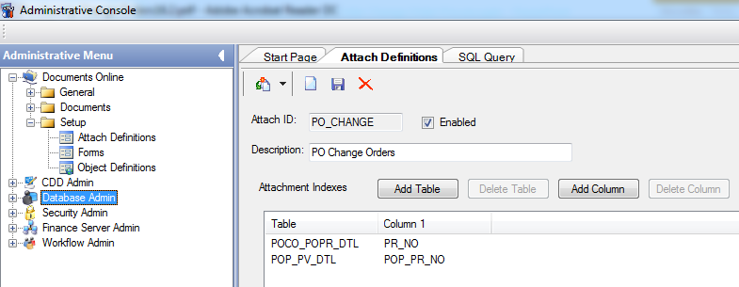
System Configuration
The attachment definition shown in the screen shot to the right allows the PO change order to be attached to the changed order and then flow through to Purchasing.
The PO_CHANGE approval workflow should also be loaded and modified as needed.

Slide 15
The Change Order Process
Creating and Modifying Change Orders
Submitting the Changes
Sending Changes to Purchasing
Verifying Changes

Slide 16
The Change Order Process
Step 1: Creating a Change Order
Use the PO Change Order process to extract, modify, and submit change orders for approval. Once extracted, you can add, update, and delete line items on a purchase order.
When you open the Change Orders screen (POUPCO), the Set Management screen displays. Click Add to create a new change order.

Slide 17
The Change Order Process
PO Number – The PO number for the change order.
Change Order Ref – This field is populated automatically when you click Save. This number is the PO number with a sequential number.
Description – Description on the change order.
Request Date – Request date of the change order

Slide 18
The Change Order Process
Type – Type of change order:
CO (change order)
CX (close/cancel)
Change Status – This field is set by the system. All new sets have a status of NW.
AP (approved)
AX (change order exception)
CA (canceled)
NW (new)
SN (sent)

Slide 19
The Change Order Process
Note: You can create a Workflow model to automatically select CA status when a set is rejected in the WF process. Sets with CA or SN status can’t be edited or deleted.
Fiscal Year – The fiscal year of the change order.
Notes – Additional notes about the change order.
When you click Save, the PO Change Order screen displays.

Slide 20
The Change Order Process
The original PO data is extracted and displayed on the screen.
When you have extracted the PO to create a change order, you can add, update, and delete line items.

Slide 21
The Change Order Process
The top of the Change Orders screen displays the purchase order information. These fields are read-only.
PR – The purchase request number.
PO – The purchase order number.
Status – The purchase order status.
Sec Cd – The security code on the purchase order.

Slide 22
The Change Order Process
Original PO Total – The original PO total.
Previous Change Order(s) – The total of previous change order(s).
Current Change Order – The total of the current change order.
Total – The total of the original purchase order + previous change orders + this change order.

Slide 23
The Change Order Process
Vendor Tab
Vendor – The vendor ID as defined in Person Entity.
Addr – The vendor address code appearing on the original purchase order.
Remit To Tab
Remit To – The remit to ID as defined in Person Entity.
Remit To Addr – The remit to address code appearing on the original purchase order.

Slide 24
The Change Order Process
Ship To Tab
Ship To – The ship to ID as defined in Person Entity.
Ship To Addr – The ship to address code appearing on the original purchase order.
Bill To Tab
Ship To – The ship to ID as defined in Person Entity.
Ship To Addr – The ship to address code appearing on the original purchase order.

Slide 25
The Change Order Process
Details Tab
Confirming Person – Name of the confirming party.
Cust/Order – If the account is established with a vendor or a PO exists with a vendor, you can enter the number here.
Bid – The bid number associated with the purchase order.
Contract # – The contract number associated with the purchase order.
End Use – Delivery requirements or miscellaneous field.

Slide 26
The Change Order Process
Details Tab
Buyer – Buyer associated with the purchase order. The buyer must be defined in the PE database.
PO Type – (Read Only) The purchase order type.
Pay By Amount – (Read Only) Check this box to direct the system to receive and pay by dollar amount.
Account Terms – The terms of the contract.

Slide 27
The Change Order Process
Dates Tab
Required Date – The date the purchase order is required.
Expiration Date – The date the purchase order expires.
Expected Date – The date the Purchase Order is expected to be delivered.
Delivery Date – The date the Purchase Order is delivered.
Blanket Tab
Banket No – The master blanket number tied to a purchase order.
Amt – The amount of the blanket order.

Slide 28
The Change Order Process
Req Codes Tab
Requisition Codes – You may enter up to 10 requisition codes. Any values entered in the requisition code fields must be defined in common codes under the category PORC.

Slide 29
The Change Order Process
ItemsTab
The Items tab displays the line items on the purchase order. You can edit and delete these records.
Changed – This check box is checked when the line is modified.
Item – The line item number.
Account (required) – The GL account, optional JL account, and optional Work Order appearing on the original invoice line
Description (required) – The line description.

Slide 30
The Change Order Process
ItemsTab
Quantity – The quantity.
Unit Price – The unit price.
Extended Amount (Read Only) – The extended amount of the line item.
Product Code – The inventory item number or product number of the purchased item. The product code must be defined in the product information screen.
Extended Amount – The total dollar value of the line item.

Slide 31
The Change Order Process
ItemsTab
Tax Code (optional, 4 chars) – The first tax code.
Tax Amount (optional, numeric, 2 decimals) – The first tax amount.
Tax Code 2 (optional, 4 chars) – The second tax code.
Tax Amount 2 (optional, numeric, 2 decimals) – The second tax amount.
Fixed Asset Flag – Select Y if this item is to become a fixed asset. The purchasing system can set this automatically if you define the POFA common code and a record qualifies.

Slide 32
The Change Order Process
ItemsTab
Charge Code (optional, 4 chars) – Choose a charge code from the list.
Charge Amount (optional, numeric, 2 decimals) – Enter the charge amount. When a charge code is selected, the system calculates the amount.
Duty Code (optional, 4 chars) – choose a duty code from the list.
Duty Amount (optional, numeric, 2 decimals) – Enter the duty amount. When a duty code is selected, the system will calculate the amount.

Slide 33
The Change Order Process
Logging Tab
The Logging tab shows a summary of differences between the original purchase order line and the modified line.
New line items create a logging record displaying information about the added item.
You can’t edit logging records, but they are updated each time the record is saved.
Because no changes have been made yet to this PO, the Logging Tab is empty.

Slide 34
The Change Order Process
Logging Tab
PR Number – The purchase requisition number.
Item – The line item number.
Data Item – The property name of the changed field. These names match those listed in the data dictionary.
Old Value – The value of the field from the original/unchanged line item.
New Value – The value of the field from the new/modified line item.

Slide 35
The Change Order Process
In this example the quantity is being changed from 2 to 3 and the changes saved.
These changes will now be reflected on the Logging tab as shown below.
Because the quantity change also impacted the extended amount for the line, two records were created, one for the quantity and one for the extended amount.

Slide 36
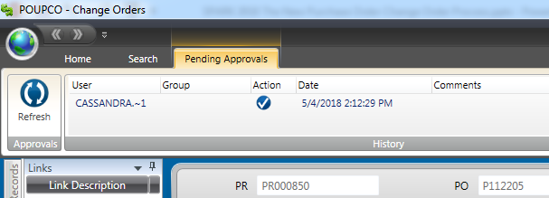
The Change Order Process
Step 2: Submitting the Change Order
When your changes are complete, the next step is to submit them through Workflow.
Saving the record initiates the Approval Workflow process.
When the changes are approved, the change order status is updated to AP (approved and eligible to be sent to Purchasing).

Slide 37
The Change Order Process
Step 3: Sending the Change Order to PO
Once a change order has been changed, saved, and approved, the next step is to send approved change orders to Purchasing. This step locates all qualifying change orders and attempts to the update all corresponding records. To qualify, a change order must:
Have a status of “AP”
Be accessible by the user running the utility
Have matching selection criteria values
When a change order is successfully sent to PO, the status becomes “SN” (sent to PO).
If the send to PO is unsuccessful, for example it fails due to a business rule error, then the change order status becomes “AX” (PO Exception).
Exception adjustments must be corrected, saved, reapproved, and then resent to AP

Slide 38
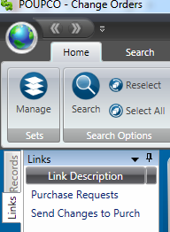
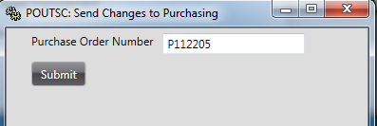
The Change Order Process
Access the job launch dialog by running PO Change Order Send to PO utility (POUTSC) from the desktop or screen link.
Purchase Order Number – Use the optional prompt to filter which change orders are processed.
Only change orders matching the provided criteria are processed.
If left blank, all change orders with a status of AP (approved) are processed.
For example, by specifying a change order number, the utility will only process change orders with a matching change order number.
Click the Submit but to submit the job request.

Slide 39
The Change Order Process
This utility updates the purchase orders that the change orders are tied to. The purchase orders are accessible on the Purchase Request screen (POUPPR).
You can also see a summary of the changes made by the utility on the tail sheet. An example tail sheet is shown in the image to the right.
The tail sheet shows the number of records read, change orders processed, POs marked for close, and records skipped with errors.

Slide 40
The Change Order Process
When a change order can’t be sent to PO, the tail sheet provides an error message about the problem.
Each change order that fails the send to PO process is listed with one or more errors describing the problem.
In the example to the right, change order DEMOEX1-001 couldn’t be sent to PO because the change order status was not AP (approved).

Slide 41
The Change Order Process
Step 4: Verifying the Changes
The purchase order is updated when you use the Send to PO tool.
You can review the modified PO on the Purchase Requests screen (POUPPR).
Changes will be shown on the Items tab and the Change Orders tab.

Slide 42
The Change Order Process
Step 4: Verifying the Changes
PO Number – The PO number for the change order.
Change Order Ref – Change order reference.
Description – Description on the change order.
Request Date – Request date of the change order.
Type – Type of change order. You have two options:
CO (change Order)
CX (close/cancel)

Slide 43
The Change Order Process
Step 4: Verifying the Changes
Change Status – Status of the change order. Select from the following options:
AP (approved)
AX (change order exception)
CA (canceled)
NW (new)
SN (sent)
Fiscal Year – The fiscal year of the change order.
Notes – Additional notes about the change order.

Slide 44
The Change Order Process
Step 4: Verifying the Changes
Note: You must run the Print Purchase Orders utility (POPO) to update encumbrances.
Run the utility manually or a setup a Workflow model to run the process automatically.
Note: If the change order is a “Request to Cancel” (type CX) when the record is pushed to the Purchasing Requisition screen (POUPPR), a Requisition Code is updated with a C.
The POUTCL- Close/Cancel Utility has to be ran to cancel the Purchase Order.

Slide 45
Conclusion
During this breakout session the following topics were covered:
Overview of the Change Order Process
Purpose
Change Order Eligibility
General Process Flow
Change Order Function Components
System Integration
Purchasing Screens Integration
WorkFlow Integration
Documents Online Integration
System Configuration
Common Code Setup
Attachment Definitions
WorkFlow Approvals

Slide 46
Conclusion
During this breakout session the following topics were covered:
The Change Order Process
Step 1: Creating the Change Order
Step 2: Submitting Change Orders
Step 3: Sending Changes to Purchasing
Step 4: Verifying Changes

Slide 47
Questions?

Slide 48
Thank You
Thank you for attending this breakout session.
I hope you found it helpful.
cassandra.shrum@superion.com

