Slide 1
Satisfaction
2019 Employee Survey Findings: Where Do We Go From Here
Engaged
Inspired
January 28, 2020
Enthusiasm

Slide 2
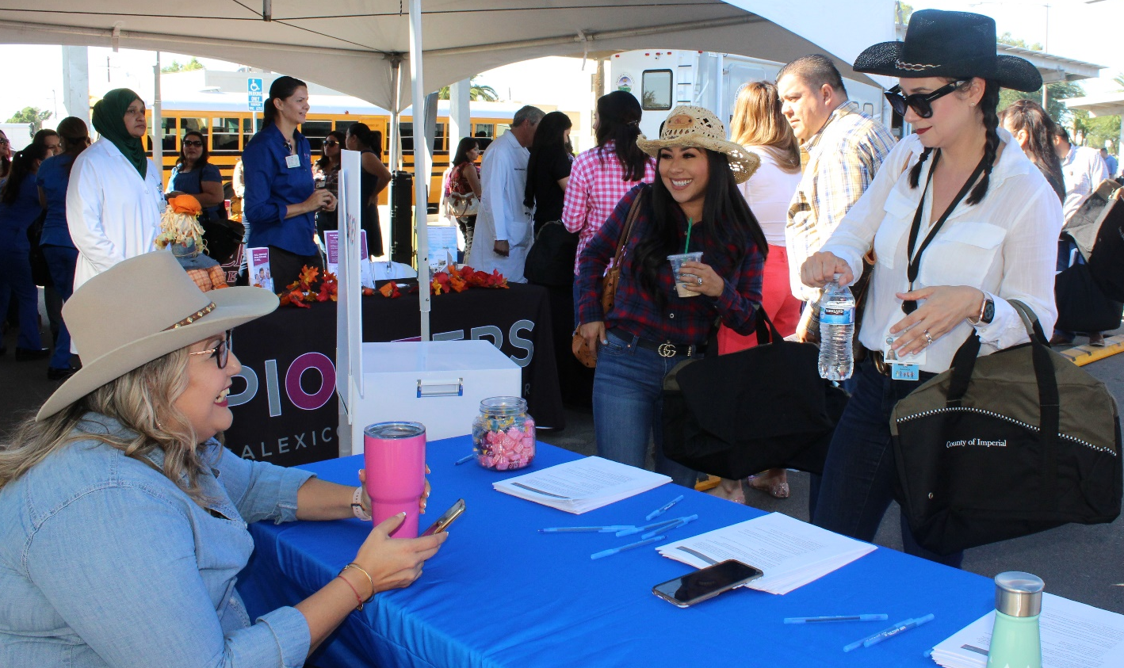
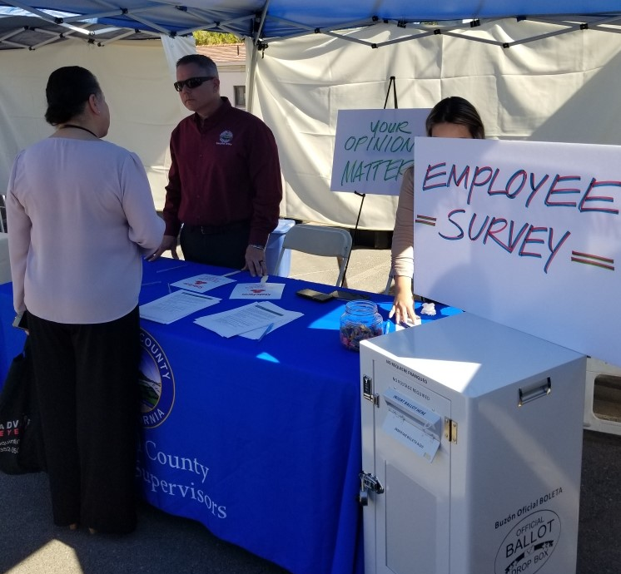
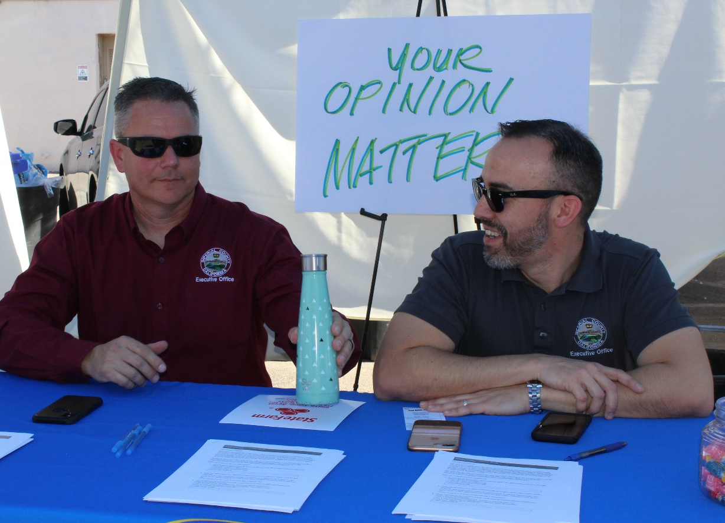
Employee Survey Kick Off Event
October 23, 2019
Day of the Employee Health Benefits Fair – Digital and hard copies were available to employees
Survey was accessible through Surveymonkey from October 23-November 28, 2019

Slide 3
Retirement
Fleet Management
Child Support
Planning &
Probation &
Services
Corrections
Development
Social Services
Services
Program Coordinator Public Safety
County Clerk and Recorder
District Attorney
Auditor-Controller
Information Technology Service
Veterans
Public Health
Clerical Administration Support
County Free
Library
Workforce and Economic Development
Manager and Supervisor
Fire
Purchasing
Sheriff Coroner-Marshal
Assessors
Human Resources
County Counsel
Air Pollution and Control
Behavioral Health
& Risk Management
Executive Office
Agricultural Commissioner
Services
Public
Public Administration /Area Agency on Aging
Treasurer/
Works
Administration
Tax Collector
Public Defender
927 responded to this question

Slide 4
Snapshot of Who Participated in the Survey
82%
72%
Office Setting
females
13%
Off-site and in the Field
28%
1,147 surveys completed
males
1,140 responded to this question
91% Full Time
Age
6% Extra Help
3% Full Time - Limited
954 responded to this question
923 responded to this question

Slide 5
Existing Department-Level Policies and Procedures
83%
Have department-level policies and procedures
7%
Do not have department-level policies
11%
are unsure
1,137responded to this question

Slide 6
Top Four Policies and Procedures Benefiting the Department
(Codes, statues, federal and state
regulations)
Customer Service
(Phone etiquette, communicating with
difficult people working with community
members/vendors, partner agencies)
55%
53%
Best Practices
Professionalism
50%
50%
1,010 responded to this question

Slide 7
Career Advancement Opportunities
Yes
No
55%
34%
12%
unsure
1,078 responded to this question

Slide 8
Employee Engagement and Relations –
Day-to-Day Activities that make a difference
86%
agree
76%
agree
73%
agree
Access to Inter and Intra
departmental job postings.
Supervisor is approachable and
easy talk to.
Two-way open line of communication between
Me and my supervisor
31%
disagree
My department shares information with me in a timely manner
1,017 responded to this question

Slide 9
Job Satisfaction – Day-to-Day Activities that make a difference
80%
agree
70%
agree
70%
agree
Ability to separate work life from family life
My supervisor has talked to me about my work. [in the last 12 months]
Informed about expectation for
day-to-day work activities.
69%
agree
56%
agree
Supervisor provides feedback and guidance at least monthly
Ability to satisfy both job and
family responsibilities.
1,013 responded to this question

Slide 10
Employee Recognition – Top Three
Spirit of teamwork and cooperation with co-workers
95%
Feeling that work is valued and appreciated
94%
Informal recognition from the department
82%
1,008 responded to this question

Slide 11
Department Trainings: Preferences and Topics
45%
38%
In-person trainings
In-person, webinars, online training, etc.
960 responded to this question
50%
44%
Stress management
strategies
Team building
45%
Effective communication
strategies
950 responded to this question

Slide 12
Feeling Valued – Top Three Choices
67%
Opportunities for Career advancement
56%
Training for professional development
44%
Receiving feedback for professional growth
942 responded to this question

Slide 13
Thankyou
Better Communication
Leadership/Management
Training
Support
Fairness
CareerAdvancement
Program Manager and Supervisor Training
Opportunities for Extra Help Workers
Management Training
Transparency
Better Pay
Leadership
honor confidentiality

Slide 14
Satisfaction
Next Steps
Additional training opportunities
Creation of policies
Review and adjust current policies
Create succession planning
Increase Employee involvement
Engaged
Inspired
Enthusiasm

